Slide 1




Welcome
Homecare Service Forum
17th May 2023
This Session will begin shortly

Slide 2
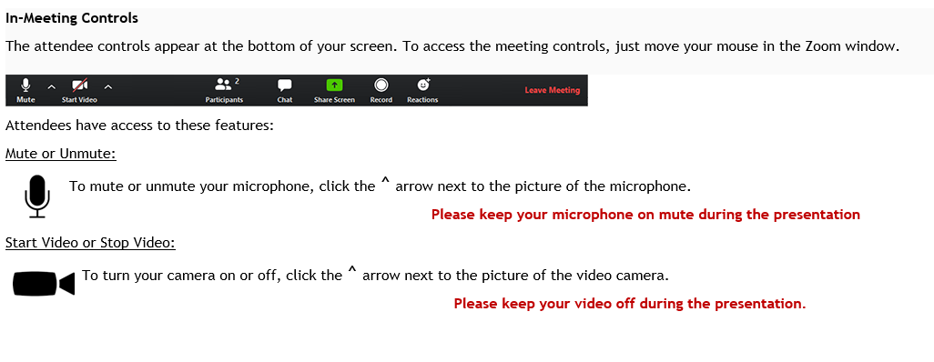
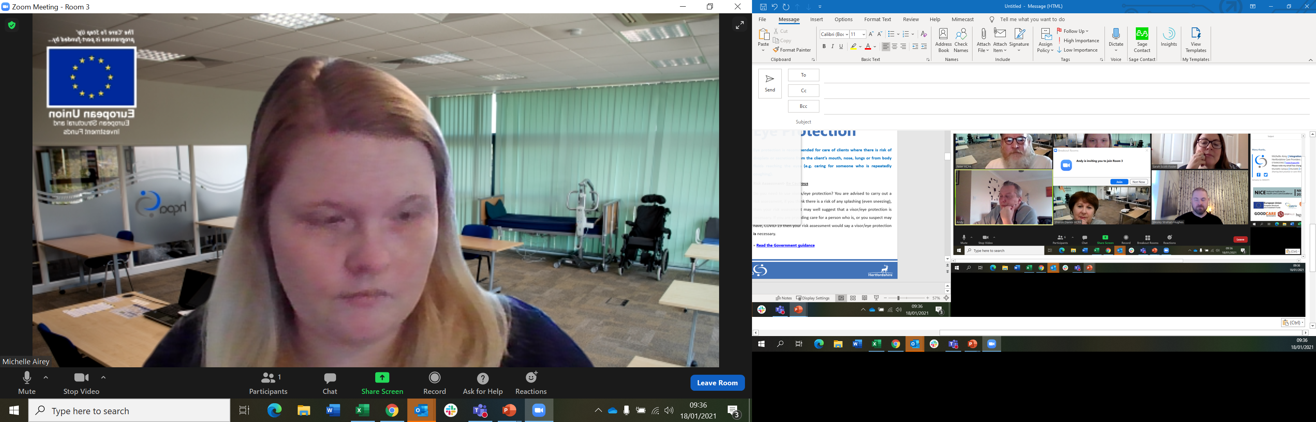
House Keeping
If you are in the wrong break out room, please click leave and select Leave Breakout room and you will be taking back to main event to be reassigned
Microphones off unless asked to speak or speaking
For questions, please add these to the chat box, we will come to these at the end, you may be asked to elaborate over the microphone

Slide 3




Agenda
10:00 – Introductions and house keeping
Event closes
HCPA Updates
Break
Focus on Culture
Oliver McGowan training requirement
ICS Health Update
International Recruitment - Feedback
Digital Care Records – Funding and Quality Records
Breakout Room- Networking
HCC Quality Trends
Notes:
Michelle
As you can see from the Agenda we are going to spend most of our meeting time today together in the main part of the event. We feel that the information we are going to go over with you is relevant to all service types.
We will however still have a session at the end of the meeting where we will give you any service specific notices and where you will be able to ask questions
Can we move to the next slide please

Slide 4

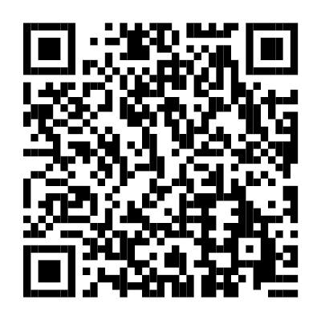
If you are a service that currently has a contract with HCC, then you should have recently received a letter about the Workforce Return for Market Sustainability and Improvement Fund.
To secure this funding HCC need your help by confirming the number of ‘new’ recruits and the number of staff who left a job in April 2023.
All you need to do is complete the online form available here:
REMEMBER - this secures the funding HCC have already passed on to commissioned providers in fee uplifts and will support HCC in gaining any future funding, so it is imperative that you take a moment to complete this.
DEADLINE: 17th May 2023
Scan the QR code or visit the following link:
https://surveys.hertfordshire.gov.uk/s/F6CCW3?mc_cid=be3ae1ebb4&mc_eid=b1185e6cde

Slide 5

The HCPA Team value each provider as individuals, working alongside each organisation to develop values skills and objectives. Bridging gaps between statutory and non statutory organisations
The New Membership Year. What's New 2023 - 2024
Updated benefits to Silver and Gold
New membership brochure and others
New fully funded projects and initiatives
‘Ask Us Anything’!
All your usual HCPA benefits plus more

Slide 6

With Exclusive access to…
Manager mentoring and coaching including support in a crisis
24/7 access to the government recognised Provider Hub support line
Free access to our nationally recognised recruitment service
Toolkits and checklists to help quality assure your business
Bespoke fully funded Care Sector training
Invitation to member networking events
Make the most of your 2023 HCPA Member Benefits

Slide 7

As a membership organisation we partner with leading businesses to support you in all your business needs. As a member you have exclusive access to...
Legal advice - 15% off Ridouts headline prices
Up to 30% off essential supplies and clothing with Arco
Exclusive discounted prices on photocopying equipment and bulk printing with Inception
Preferred rates to join Peninsula Business Services, assisting with HR and Health and Safety
Member rates on telecoms, mobile phones, SIM cards and Wi-Fi via SimCredible
Preferred rates with Towergate insurance
Large savings on Utility bills via Business Saving Experts
Access to lower cost business support, consultancy, policy writing, food solutions and IT via our partner services

Slide 8



SILVER ELIGIBILITY
At least 10% of your staff using free Academy staff benefits.
2 x people who have each attended designated leadership courses.
Silver Benefit
Leadership culture ½ day course (webinar style, open to all silver members, by invitation, no cap)
GOLD ELIGIBILITY
STAN
IFS
Culture Check
PAMMS/CQC Good overall rating
Gold Benefit
Marketing package (Gold shout out/ Gold logo / Gold membership list in brochure)
Bespoke Behaviours Framework consultation with Leadership T.E.A.M ½ day

Slide 9
Membership:- Next Steps…
All members, both current and new to fill out a membership form. This will enable us to set up the new Database with your most recent up to date information on your organisation.
If you haven’t yet done this for 23/24 membership year please do so.
If you pay by direct debit, simply close the second page down on the membership form, unless your direct debit details have changed in which case do fill this section out again and we will update your payment details.
If you pay by invoice and haven’t yet paid this, we will need payment before we can send out your certificates.
Anyone who has silver or gold status will be sent their specific certificates out separately in the next few weeks. You will all be receiving a standard membership one shortly if you haven’t already.
Notes:
Please remember si sign up

Slide 10




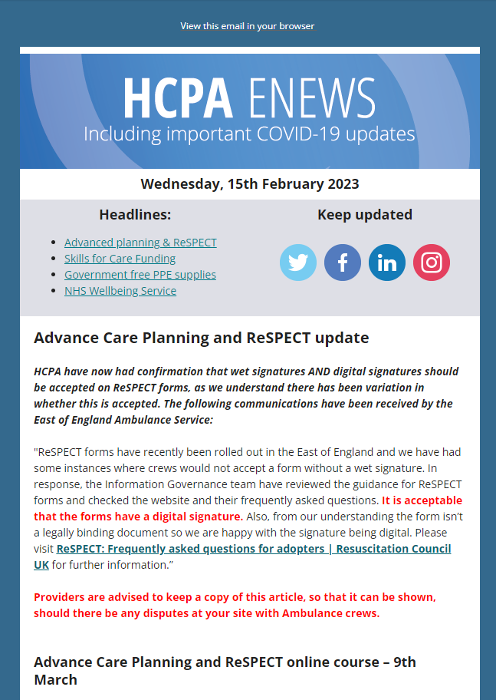



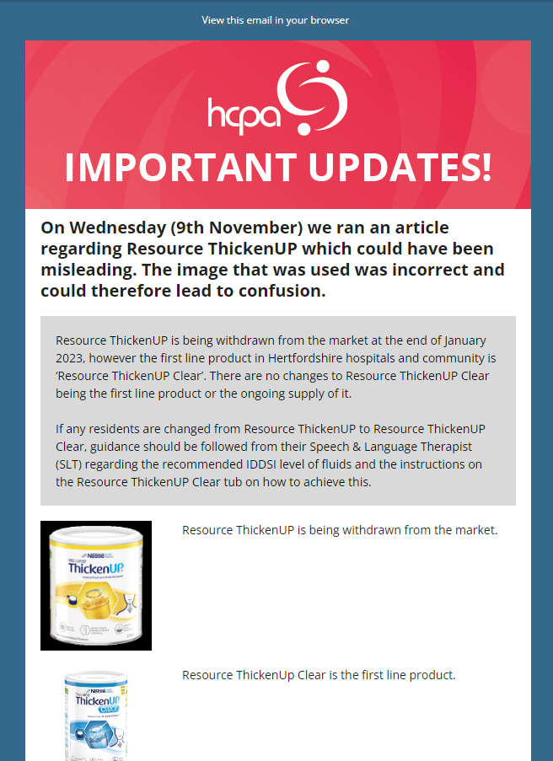








Newsletters
Notes:
Please remember si sign up

Slide 11

Notes:
New IFS aligned to 5 Key Questions, 6Cs Culture Check, Business Continuity Planning Support, Executive Coaching and our new Inspection Support service all now available for HCPA members fully funded by HCC.
International Recruitment - Eastern Region funded to develop a Centre of Excellence for East of England (which includes Hertfordshire). Lots of work going on behind the scenes and we will be in contact to ask for opinions, feedback and advertise what is being put in place to support.

Slide 12

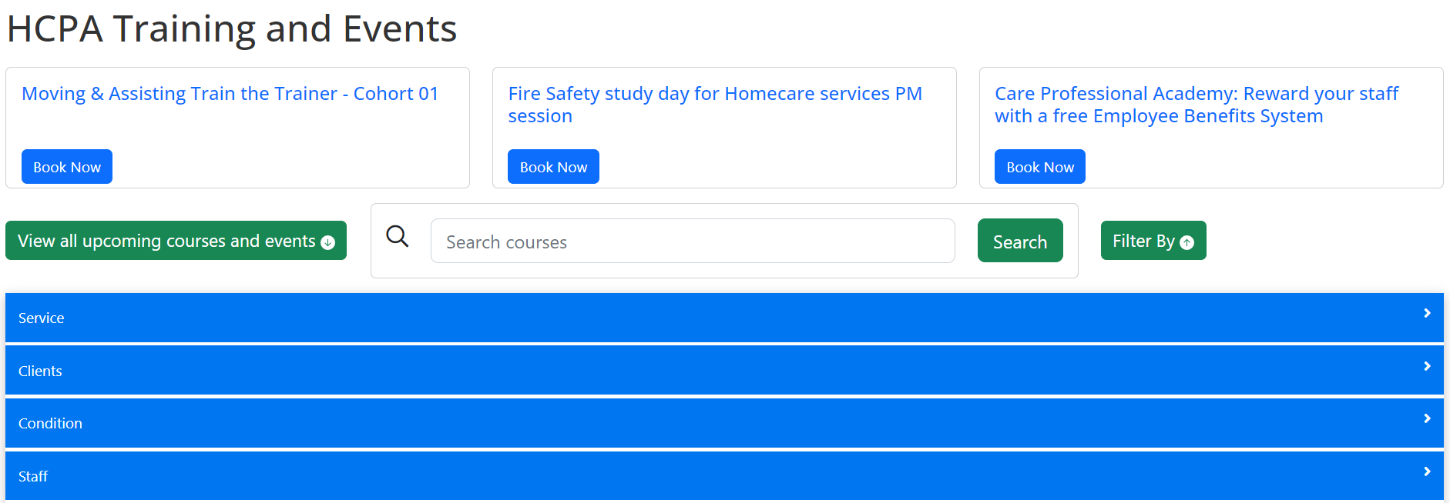
New Booking Website
Leadership
Funding
Approved Trainers
Qualifications

Slide 13
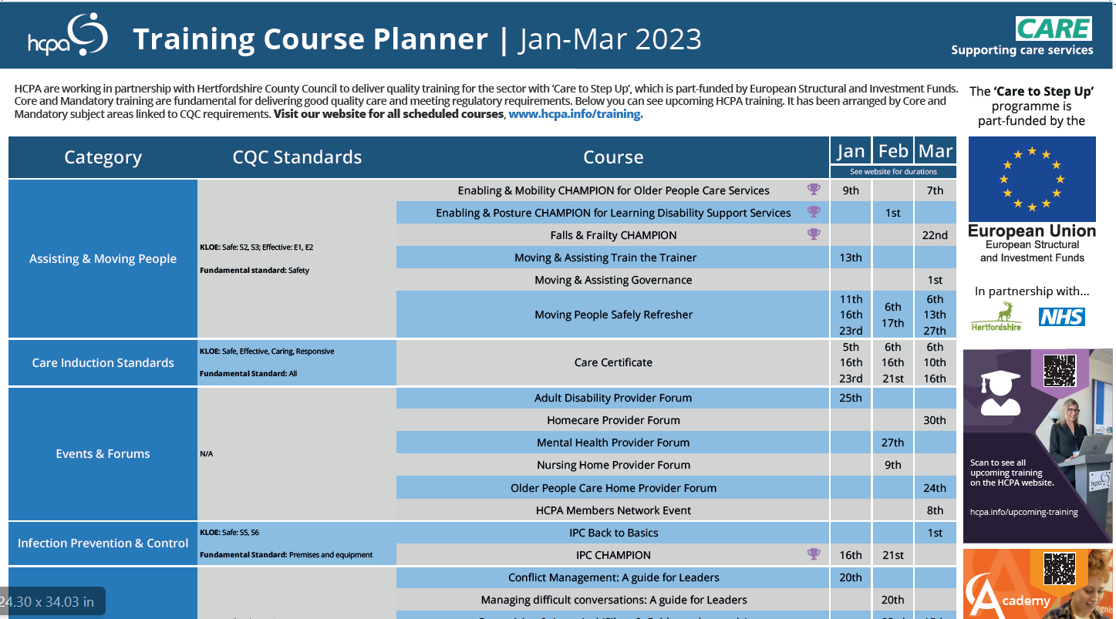

Slide 14

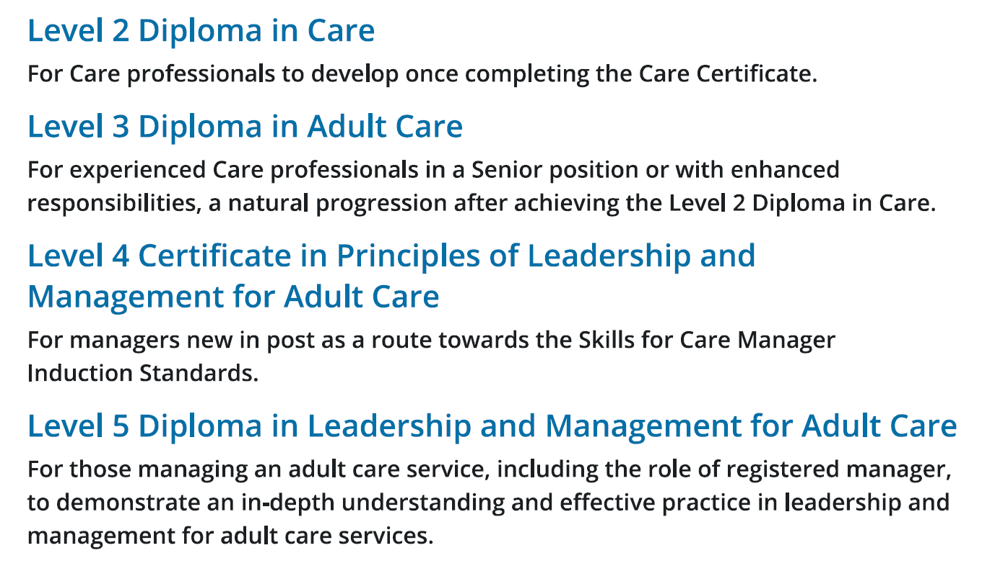
Qualifications
Claim back costs via WDF!
Notes:
It’s important that staff are equipped with the right skills and knowledge to provide high quality care and support. Investing in learning and development opportunities can help to support staff retention, whilst ensuring employees feel valued.
Qualifications play an important role in learning and development and are available for Care professionals at various levels and size dependant on their role, assessed against expected knowledge, skills and behaviours.
he Workforce Development Fund (WDF) is funding from the Department of Health and Social Care (DHSC) disseminated by Skills for Care.
It supports the provision of high-quality care and the continuing professional development of staff across the adult social care sector by providing a contribution towards the costs of vocational learning.
This includes money towards the cost of course fees, associated costs such as employees’ salaries whilst they are undertaking training, coaching and mentoring costs, and wage replacement costs.
By joining HCPA’s partnership you will have access and support to claim back money towards the costs of staff completing a range of qualifications or learning programmes upon completion (subject to eligibility and available funds)

Slide 15


Slide 16

Integrated Community Support Team
Quality Monitoring feedback
Alex McInally
Commissioning Manager

Slide 17
Quality Monitoring
Every year we speak to people supported by commissioned support at home providers
Routine (as part of PAMMS contract monitoring) or ad hoc monitoring
Standard template of questions, sometimes tailored where concerns raised
  Quality of care
  Communication, complaints
Responses collated into report and shared with providers and operational colleagues for any required follow up

Slide 18
Positive Feedback
Communication
Office communicate well and are very helpful. They keep family informed of any health changes
They arrive when she expects or call if running later than 30 minutes. Could not wish for better.
Consistency
Care has been absolutely excellent and she could not fault the care at all. In the beginning she was getting all different care workers but it seems to have settled into a group of 4-6 regular care workers and this works well with her dementia
Had 4 regular care workers and they are giving him the best care possible and provide a quality service since his stroke. They work as a team.
General
All good workers and would recommend them to anyone. Very satisfied and feels lucky to have them.
Cannot praise the care staff enough. Feels that they are devoted, kind, knowledgeable and experienced.

Slide 19
Positive Feedback
Caring
They were very patient and lovely people and he enjoyed their visits and they were very friendly towards his wife, they could not be faulted.
She gets on well with [named care workers] – all three have eyes like hawks and they address any problems with her skin integrity immediately. They are very patient and extremely good. The provider seems to look after their carers and he has not heard a bad word from any of the carers about the management.
They were very good at encouraging her to do as much as she could herself and realised if she was having a 'down' day.
They have a really good rapport with him and give good feedback They are very professional and brilliant with him. They connect and sit with him when he is eating and draw him out by asking questions. They know his moods as they have been working with him for many years and she said you can tell he really likes them.
[Named care worker] is fantastic and goes above and beyond, she is more like a friend and they have a laugh and chat during her visits and all the tasks are done. She is very efficient and intuitive.

Slide 20
Areas to consider
Consistency
Inconsistent with timings and arrive late in the mornings and early in the evenings.
When regular care worker has a couple of days off it tends to be very rushed care in the mornings particularly and they do sometimes leave after 20 minutes, but have completed all the tasks.
No concerns regarding quality of care, but not impressed with the amount of different care workers
Says she would prefer more consistency with care workers and would like care workers that are fluent in English as otherwise they don't talk to her.
Gets on well with regular care workers but they are very quick. Needs are met but do not stay for the full amount of time allocated.
Communication/General
The office could have better communication and let her know when care workers will be late
Some of them are quite new and don't always know what to do.
Staff are pleasant and nice but could be better trained in food prep as one of the tasks involves making sandwiches and scrambled egg and they have not known how to do this

Slide 21
Areas to consider
Language/Cultural Issues
The care workers don't really speak much, as they can't speak English.
Feels uncomfortable with care workers talking across him in their own language and not including him in conversation.
Communication a bit hard at times as English not their first language and they do not seem to understand about diabetes.
There is a bit of a language barrier. They try to make themselves understood and he asks them either to repeat slowly or show him what they mean.
Some misunderstandings due to cultural or language differences.

Slide 22
thank you

Slide 23


Slide 24
Sharon Davies
HCPA CEO

Slide 25

Focus on Culture – how to meet CQC’s desire to see Culturally Appropriate Care
Sharon Davies
CEO, HCPA
Notes:
This presentation will look at the THREE steps you need to meet the new focus CQC will have at inspection on ‘Culturally Appropriate Care’

Slide 26

Why is setting a good culture so important?
Notes:
Before the three steps – take a step back and look at your organisation
A great culture stems from a great leadership team
A leadership team who really care, will be looking for staff to show amazing behaviours
A strong leadership team will not put up with behaviour which is not aligned to the company values and brings the rest of the team down
Two areas you may want to look at when considering culture is your recruitment and your retention. For both of these we have a tool to support you

Slide 27

Think about the 6 C’s of Care
Care
Compassion
Communication
Courage
Competence
Commitment
What are the behaviours you would expect under each heading?
What would you not expect?
Have you got a company behaviours framework?
Email marketing@hcpa.co.uk for a template
Tip! Consider if your leadership team have had time to really think about your company culture and what part they play. Bespoke training may support you in this – see our INSPIRE programme - https://edition.pagesuite-professional.co.uk/html5/reader/production/default.aspx?pubname=&edid=794ae9d3-e235-4713-ad6a-98e7325df7eb
Notes:
But before the tools here is something to consider…do your staff know what you expect? Is this written down? Do you make this clear at the start of employment and
What are the behaviours you would expect under each heading?
What would you not expect?
Have you got a company behaviours framework?
email us for a template
Tip! Consider if your leadership team have had time to really think about your company culture and what part they play. Bespoke training may support you in this – see our INSPIRE programme
do you constantly remind staff?

Slide 28

Recruitment: Curious about Care
Values-based recruitment is essential to ensuring your organisation employs a compassionate, person-centred workforce that is committed to providing quality care.
It can be tricky to know how to assess a candidate’s values and whether they align with those of your organisation. Skills for Care has been working with social care experts at University of York to create Curious about Care. This free, evidence-based tool can be used as part of your recruitment process to help you make a decision.
Visit Curious about Care to try out the free tool.
Breezy is a short online interview tool which will help you to shortlist candidates https://app.breezy.hr/signup?scta=home-header
Cost around £1500-£2000pa
Notes:
STEP ONE
So, thinking about recruitment and remembering that the most important thing is to get the right people in in the first place
We all know the current issues with recruitment but you really have to stop and ask yourself what challenges you are posing yourself and your team if you employ someone with the wrong values and behaviours.
Really try to assess the people coming in to work in your service, whether they are national or international recruits.
At HCPA, we have been using profiling tools for years in our recruitment service – and they work! This one from Skills for Care has recently been released, it is free, so it’s a no brainer!
We would suggest that you, start with an online test such as the SfC tool, then shortlist, ask for a video interview (think carefully about questions that will show you the person’s values – such as “tell me a time when you have helped a person and explain what you did and how it made you feel”), shortlist again and then interview…remember to use values based questions, never ask a person what would you do, only ever ask for examples which are real. If you want help with values based interviewing then give us a call and we can direct you to specific training.

Slide 29

Retention: Why check your culture?
This service is FREE to all HCPA members. www.hcpa.info/services/6-cs-culture-check/
Notes:
So, we have spoken about recruiting the right people, now you have them you need to keep them. This is STEP TWO.
Staff stay in organisations where they value the culture and feel aligned to the culture. As leaders this is something you cannot take for granted, you have to make sure that your staff are continually feeling valued and feel they are making a difference.
The Culture Check is here for you to take a snap shot of the feelings of your staff towards your company.

Slide 30




Gathers feedback from staff on how they view the culture of your provision
Identifies the health of your provision and stability of your staff
Highlights areas of development, loyalty of your staff and aids retention and recruitment process
Provides a user friendly and quick online survey which is easy to read and anonymous
This is a Free Service for HCPA Members
Notes:
The Culture check is again focussed on the 6 C’s
It’s an electronic survey so staff can do it on their mobile phones
Its anonymous and it gives you a report

Slide 31
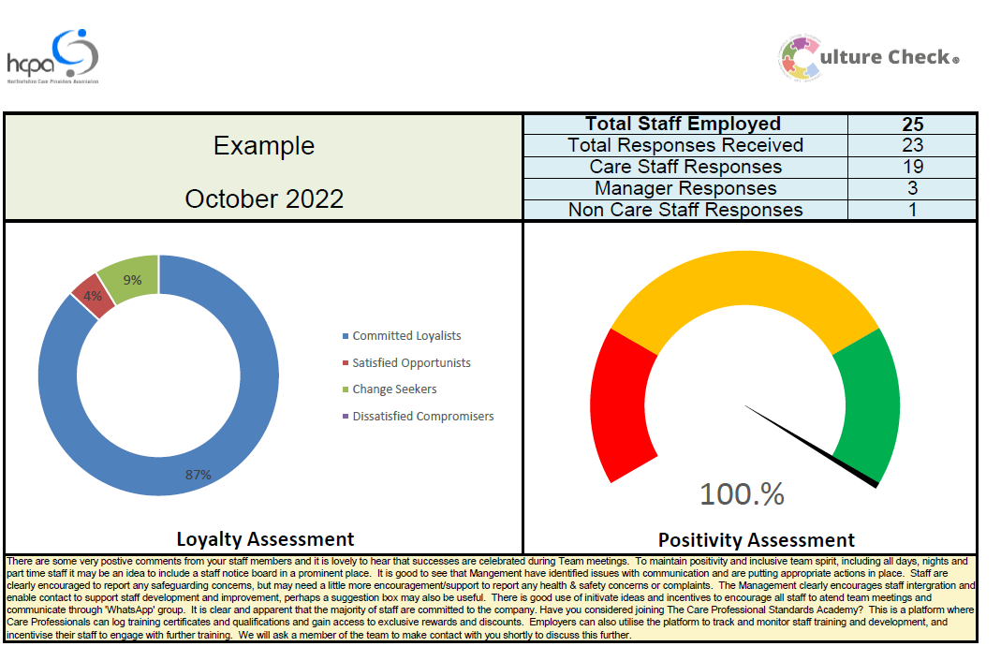
Notes:
Here is an example of a report generated from the Culture Check

Slide 32
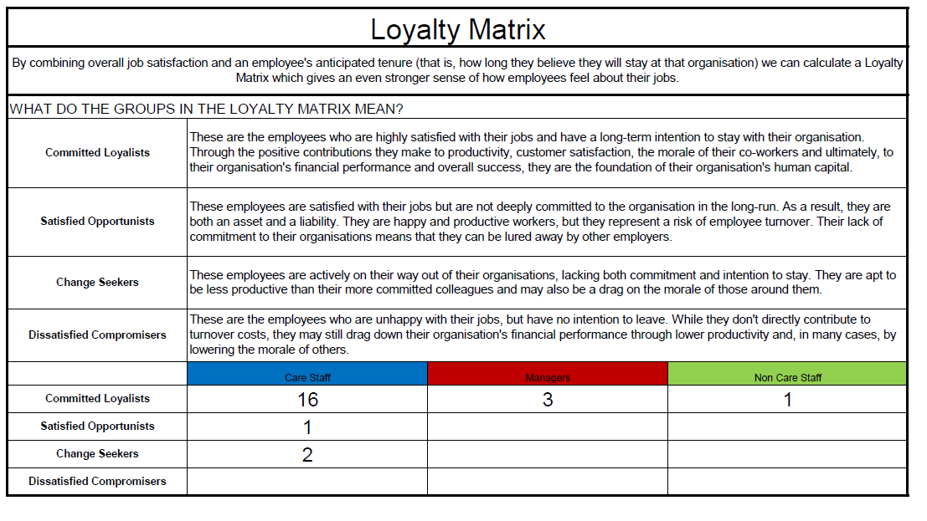
Notes:
And from the results you can start to see how your staff are feeling. The next step is to take is to consider your actions needed

Slide 33
Culturally Appropriate Care: Use your company culture to promote this
If you get the staff culture right, you will create a culture where staff are also thinking about the people you support and want them to have a culturally appropriate experience
Everyone is part of a culture. People need their culture to be recognised and their cultural needs met to feel happy and comfortable. But some people's cultural needs are more likely to be met because they are closer to cultural norms in the service.
You do not have to be an expert on different cultures. But it helps to understand how culture can affect aspects of care.
Notes:
So, now we come onto the part where CQC will be looking at you. This is STEP THREE
If you get the right people and the right culture you will automatically be in a great position to provide ‘Culturally Appropriate Care’
Because your staff will have the right attitude, that of course isn’t to say that they may not also need some training or some additional research to support a person with their cultural needs

Slide 34

Examples of culturally appropriate care
These are some examples of culturally appropriate care, including many we've seen when we've carried out inspections. There are many different aspects and variations in culture. Providing care should always be based on an assessment of individual needs.
It's important to:
ask the person or their representatives what they prefer and then to meet their preferences wherever possible
try to understand a person’s history by talking to them and their family
ask questions if you are unsure
be curious about what the important things are to help people live their fullest lives
Notes:
This is taken directly from the CQC website – remember to build this into care plans
It's important to:
ask the person or their representatives what they prefer and then to meet their preferences wherever possible
try to understand a person’s history by talking to them and their family
ask questions if you are unsure
be curious about what the important things are to help people live their fullest lives

Slide 35
Key points for registered managers
Building your staff's confidence in person-centred care will help them deliver culturally appropriate care. Discussing how to meet cultural needs in team meetings can also help build confidence.
Everyone's cultural needs should be part of their care planning and review.
Providing culturally appropriate care is everyone's responsibility. But managers have a particular role in acting as a bridge between different cultures in a care setting. For example, between frontline care staff and people from a different background who are receiving care.
Being an inclusive leader means being aware of your own cultural values and the potential impact they have on others.
It's important to look at the shared culture of the service - for example, the way it's reflected in activities and decoration - as well as individual care.
Good communication with people and their families is vital to meeting cultural needs.
It's important to respect people, treat them with dignity and respect their privacy.
It's good to ask open questions in residents' meetings to find out whether cultural needs are being met. For example, “what do people think of the activities?” But people from a minority culture might be uncomfortable speaking up in an open meeting. So an informal chat outside the meeting can be helpful too.
Staff from minority groups - such as black and minority ethnic staff or lesbian, gay, bisexual or transgender staff - may also face discrimination from some people using the service. Good staff engagement and support are important to solve these issues.
If you have a diverse staff team, use the cultural knowledge and skills of your team in a positive way.
Notes:
So let’s look at what CQC say you, as the registered manager, can do…
Building your staff's confidence in person-centred care will help them deliver culturally appropriate care. Discussing how to meet cultural needs in team meetings can also help build confidence.
Everyone's cultural needs should be part of their care planning and review.
Providing culturally appropriate care is everyone's responsibility. But managers have a particular role in acting as a bridge between different cultures in a care setting. For example, between frontline care staff and people from a different background who are receiving care.
Being an inclusive leader means being aware of your own cultural values and the potential impact they have on others.
It's important to look at the shared culture of the service - for example, the way it's reflected in activities and decoration - as well as individual care.
Good communication with people and their families is vital to meeting cultural needs.
It's important to respect people, treat them with dignity and respect their privacy.
It's good to ask open questions in residents' meetings to find out whether cultural needs are being met. For example, “what do people think of the activities?” But people from a minority culture might be uncomfortable speaking up in an open meeting. So an informal chat outside the meeting can be helpful too.
Staff from minority groups - such as black and minority ethnic staff or lesbian, gay, bisexual or transgender staff - may also face discrimination from some people using the service. Good staff engagement and support are important to solve these issues.
If you have a diverse staff team, use the cultural knowledge and skills of your team in a positive way.

Slide 36
Educating your staff to be culturally aware
Everyone's cultural needs should part of their care planning and review, under the relevant sections of the care plan.
Cultural needs vary. They're not just based on ethnicity and religion. They're also based on things like age, sex, sexual orientation (for example lesbian, gay and bisexual people), gender identity (for example transgender people), disability, neurodiversity, region in the UK, family and employment history.
The way people identify with their culture can also change through time. For example, people with dementia may identify more strongly with the culture in their earlier years as they get older.
Don’t make assumptions about people’s needs based on generalisations about cultures.
Good communication with people and their families is vital to meeting cultural needs. If there are conflicting views, the person’s own wishes need to have most weight.
It's important to look at the shared culture of the service - for example, how it's reflected in activities and decoration - as well as individual care.
Cultural needs vary. They're not just based on ethnicity and religion. They're also based on things like age, sex, sexual orientation (for example lesbian, gay and bisexual people), gender identity (for example trans people), region in the UK, family and employment history.
The way people identify with their culture can also change through time. For example, people with dementia may identify more strongly with the culture in their earlier years as they get older.
If you are not sure about whether someone’s cultural needs are being met, talk to the person responsible for their care. This might be their keyworker, for example, or your shift leader. This is just as you would do with any other concern about someone's care.
Notes:
Finally let’s look at what you need to do to educate your care team, some of this is training, some of this is easily digested if spoken about regularly at team meetings, supervisions and handovers
Everyone's cultural needs should part of their care planning and review, under the relevant sections of the care plan.
Cultural needs vary. They're not just based on ethnicity and religion. They're also based on things like age, sex, sexual orientation (for example lesbian, gay and bisexual people), gender identity (for example transgender people), disability, neurodiversity, region in the UK, family and employment history.
The way people identify with their culture can also change through time. For example, people with dementia may identify more strongly with the culture in their earlier years as they get older.
Don’t make assumptions about people’s needs based on generalisations about cultures.
Good communication with people and their families is vital to meeting cultural needs. If there are conflicting views, the person’s own wishes need to have most weight.
It's important to look at the shared culture of the service - for example, how it's reflected in activities and decoration - as well as individual care.
More key points for care staff
Cultural needs vary. They're not just based on ethnicity and religion. They're also based on things like age, sex, sexual orientation (for example lesbian, gay and bisexual people), gender identity (for example trans people), region in the UK, family and employment history.
The way people identify with their culture can also change through time. For example, people with dementia may identify more strongly with the culture in their earlier years as they get older.
If you are not sure about whether someone’s cultural needs are being met, talk to the person responsible for their care. This might be their keyworker, for example, or your shift leader. This is just as you would do with any other concern about someone's care.

Slide 37
EXERCISE: Creating another survey to support you in providing culturally appropriate care
In groups think about what you would put in a survey to understand if your organisation is delivering culturally appropriate care
Notes:
So, we have looked today at the three steps you need to take to ensure you are providing Culturally Appropriate Care.
Remember to check you have a clear expectations set out in a strong behaviours framework, once this is in place, then look at Step One – Your Recruitment, Sep Two – Your Retention and Step Three – Your focus on providing Culturally Appropriate Care as standard.
We are happy to create another tool for you to use, it would be similar to the staff survey on culture but would ask specifically about culturally appropriate care. We wanted you to come up with some ideas of questions we may ask your staff.
In groups, please think about what questions you could come up with which we could use in the tool.
I will put back up the Key points for registered managers slide which may help you.

Slide 38
Feedback International Recruitment
Please add your challenges or good practice to the chat

Slide 39


Slide 40

Emma Slater emma.slater5@nhs.net

Slide 41
Michelle Airey
Head of Education and Quality Improvement

Slide 42


HCPA Offer
Oliver McGowan
Tier 1: Webinar
The Oliver McGowan Mandatory Training on learning disability and autism is the standardised training that was developed for this purpose and is the government’s preferred and recommended training for health and social care staff to undertake.
It is named after Oliver McGowan, whose death shone a light on the need for health and social care staff to have better training.
Open Courses
TTT
Group Delivery
Core Capabilities
Code of Practice
Roll out and Monitoring
Notes:
Set against CQC Core Capabilities for Autism and Learning Disabilities
Code of Practice due in the Summer from CQC
Inspectors starting to ask providers there roll out plan
Requirements- Tier 1 E-Learning, Tier 1 Experts by Experience and Tier 2, Tier 3 TBC
Mapping- Look at what training currently exists
Training Matrix- Add as Mandatory Topic
HCPA Offer- Tier 1 E-Learning content and Experts, Tier 2 Open courses, Tier 2 Direct at services, Train the Trainers Tier 1 and 2, Basic Mapping tool
HCPA will start delivery of Education from June 2023. HCPA will be offering a mixture of -
Tier 1 workshops via Zoom
Tier 2 (Face to face) open courses at HCPA offices
Tier 2 Group sessions at provider site
Tier 2 Train the Trainer.
To complete the Tier 1 workshop or any Tier 2 sessions delegates must complete the E-Learning for Health Oliver McGowan training, delegates will be asked to show proof of completion. It is recommended to complete E-Learning no more than 6 weeks prior to doing Tier 1 workshop or Tier 2.
If you are interested in applying to undertake the Train the Trainer programme click here
If you are interested in Tier 1 or Tier 2 training for your staff, complete an Expression of Interest here
Any other questions please email olivermcgowantraining@hcpa.co.uk

Slide 43
Mandatory E-Learning for Health
The Oliver McGowan mandatory training on learning disability and autism is the government’s preferred and recommended training for health and social care staff and it is delivered in 2 tiers.
The E-Learning which is now live and is part 1 of both tier 1 and tier 2.
The content of the E-Learning session is mapped to the Tier 1 learning outcomes of the Core Capabilities Framework for Supporting Autistic People and the Core Capabilities Framework for Supporting People with a Learning Disability.
It should take you one hour and 30 minutes to complete.
To access the E-Learning - The Oliver McGowan Mandatory Training on Learning Disability & Autism

Slide 44
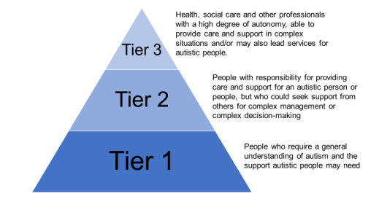
HCPA Offer
Oliver McGowan
Tier 1: Webinar
Open Courses
Direct Delivery
Mapping Tool
Core Capabilities
Code of Practice
Roll out and Monitoring
Notes:
HCPA will start delivery of Education from June 2023. HCPA will be offering a mixture of -
Tier 1 workshops via Zoom
Tier 2 (Face to face) open courses at HCPA offices
Tier 2 Group sessions at provider site
Tier 2 Train the Trainer.
To complete the Tier 1 workshop or any Tier 2 sessions delegates must complete the E-Learning for Health Oliver McGowan training, delegates will be asked to show proof of completion. It is recommended to complete E-Learning no more than 6 weeks prior to doing Tier 1 workshop or Tier 2.
If you are interested in applying to undertake the Train the Trainer programme click here
If you are interested in Tier 1 or Tier 2 training for your staff, complete an Expression of Interest here
Any other questions please email olivermcgowantraining@hcpa.co.uk
Both tiers consist of 2 parts.
The first part of both tier 1 and tier 2 is E-Learning.
Everyone will need the E-Learning regardless of where they work and the tier of training they require. It is free to access.
The second part of the training is either a live 1 hour online interactive session for those needing tier 1, or, a 1-day face to face training for people who require tier 2.

Slide 45
Experts with Lived Experience involvement and Applications
HCPA have been funded to support the roll out of the Oliver McGowan Mandatory Training for Hertfordshire and West Essex for CQC Registered Health and Social Care providers. A key part of the training is to include Experts with Lived Experience as Co-trainers. These co-Trainers will co-train with our HCPA training team. The Experts with Lived Experience must either have a Learning disability and/or be autistic.
HCPA are happy for individuals to apply for hours that suit them, this could be between 1 and 5 hours per week.
Please find full Application Pack here and Easy Read here
Applications close on Friday 19th of May 2023
Any queries please email olivermcgowantraining@hcpa.co.uk

Slide 46
Michelle Airey
Head of Education and Quality Improvement
Maisy Hockey
Education and Quality Improvement Projects Manager

Slide 47


Quality Care Records
Whether paper based or digital the record needs to be quality!
Notes:
Common theme from local and national monitoring
The world is going digital

Slide 48


Digital Social Care Records
What are Digital Social Care Records?
A Digital Social Care Record (DSCR) is a system that allows the digital recording of care information and care received by an individual. DSCR’s should replace traditional paper-based recording.
Notes:
Digital social care records (DSCRs), alternatively known as electronic care planning systems, enable improvements in the safety and quality of care and improve communication between adult social care and health settings. They free up time spent by care workers and managers on administrative tasks and make sure that everyone has the right information they need to deliver the best possible care.

Slide 49
CQC Recognised Benefits of Digital Social Care Records
provide ‘real time’ information recording about the care and support people need and receive
help providers and staff to be more aware when people’s needs change, and respond to them more quickly
help information to be shared quickly, accurately and safely to support the provision of health and care services
help to minimise risks such as medication errors, dehydration or missed visits
help to manage and support staff to do their job effectively and efficiently
be easier to store, requiring less physical space
Notes:
CQC identifies the benefits of a DSCR as:
providing ‘real time’ information recording about the care and support people need and receive
helping providers and carers to be more aware when people’s needs change, and respond to them more quickly
offering the ability to use and compare data to improve people’s care
helping information to be shared quickly, accurately and safely to support the provision of health and care services
helping to minimise risks such as medication errors, dehydration or missed visits
helping to support other important health and care functions, such as service management, planning and research
making it easier for people who use services to access their own records
helping to manage and support staff to do their job effectively and efficiently
be easier to store, requiring less physical space
supporting better use of resources across the health and care system.

Slide 50
Importance of Good Care Planning
A clear understanding of the person completed with the person
Particularly important for agency staff, new staff and professionals
Provide clear information in an emergency
Regularly reviewed
Flexible
Evidence
Risk assessments
Future wishes
Legal documents
Notes:
Provide an outline of the person, their care needs, how to care for the person in line with the persons wishes and needs
Important for agency and new members of the team to know the individual
Support professionals and care staff to quickly know what to do in an emergency situation
Be reviewed regularly
Be flexible
Provide evidence that care needs are being met and to help understand why changes in a persons behaviour or care needs are taking place
Contain clear risk assessments
Provide an outline of future wishes
Contain legally required documents such as MCA/BIA/LPA/DNACPRs etc.

Slide 51

Outcome focused- Connected Lives
The needs of each person are identified through a Connected Lives assessment
Will also provide any key information
outcomes focussed care & support plan
risk assessments
Notes:
Care Plans should clearly reflect the individual and be completed with the person, their carer/family to ensure their needs and wishes are clearly documented

Slide 52
Considerations
Key documents and templates
Prompts
Involvement
Flexibility
Trends and themes
Notes:
Ensuring key documents are included
Provide prompts for regular checks and reviews
Evidence involvement
Allow greater flexibility when changes occur
Provide tools for reviewing and demonstrating trends and change in needs

Slide 53
Hints and Tips
Personalised – including daily records
Involvement
Regularly reviewed
Clear evidence
Reflective of need
Contingency plans
Staff training and confidence
Language
Notes:
Must ensure personalised, including daily records, and not task orientated
Continue to involve the individual
Must ensure the care plans are regularly reviewed- generally monthly
Must ensure evidence is clearly available when actions and decisions have been taken, especially by professionals
Must ensure up to date reviews and change in needs
Clear contingency plans and solutions in case of issues such as cyber attack, loss of power, loss of internet, etc.
Must ensure staff are trained and confident in how to use
Language- Keep it professional

Slide 54
Auditing
Carried out by a senior member of the team who is competent
Look for patterns
Set a company policy for Governance
Check the notes
Evaluate when changes
Minimum of every three months
Notes:
Must ensure personalised, including daily records, and not task orientated
Continue to involve the individual
Must ensure the care plans are regularly reviewed
Must ensure evidence is clearly available when actions and decisions have been taken, especially by professionals
Must ensure up to date reviews and change in needs
Clear contingency plans and solutions in case of issues such as cyber attack, loss of power, loss of internet, etc.
Must ensure staff are trained and confident in how to use

Slide 55
Next Steps
Update Care Planning Toolkit
DSCR Supplier Forums
Access to DSCR Funding
New Care Planning course for managers

Slide 56

Digital Social Care Record Funding Offer
Notes:
Peter

Slide 57

Digital Transformation Fund for Digital Social Care Records
Hertfordshire and West Essex ICS have secured a fixed amount of funding from the NHS Transformation Directorate Digitising Social Care Programme to support the adoption of digital social care records. Hertfordshire Care Providers Association (HCPA) is acting on behalf of the ICS for all Hertfordshire providers.
We are now able to provide financial support by way of a one-off grant payment to support adult social care CQC registered providers to adopt a DSCR. The project will contribute to the continued development of the evidence base for digital social care records, evaluate the impact and share the benefits across our Integrated Care System footprint.

Slide 58
What do we hope to achieve?
80% of CQC Registered Providers using DSCR by March 2024- currently 58%
Improved digital foundations and literacy across the ICS
Increase in use of other digital technology such as eMARs and health monitoring
Good quality outcome based care plans
All providers meeting Data Protection and Security Standards

Slide 59

Digital Social Care Records Offer
50% of Year One Implementation Costs*
Licences
Hardware
Staff Time
Requirements= DSPT, Secure Email + Evaluation
*Up to £10,000
Notes:
The Local Authority will provide successful adult social care providers with up to £10,000 or 50% funding (whichever is the lower figure) per site for year one implementation costs of a Digital Social Care Record system. This will include financial support for the purchase of software, associated hardware and training costs.
NOTE 1- This does not include hardware to support infrastructure, connectivity and other devices unless they are required to support implementation of DSCR
NOTE 2- suppliers selected for this initiative must be an assured supplier listed on the NHS Transformation Directorate Dynamic Purchasing System (DPS). Grant funding cannot be used to purchase systems from any other supplier.

Slide 60
What does this initiative offer?
We will provide successful adult social care providers with up to £10,000 or 50% funding (whichever is the lower figure) per site for year one implementation costs of a Digital Social Care Record system. This will include financial support for the purchase of software, associated hardware and training/staff costs. Examples on next slide
Is there a limit to how much funding is available?
The ICS has a finite amount of funding available for this scheme. Should successful applications exceed the level of funding available, grant funding will be awarded on a first come, first served basis based on funding available and based on the submission date of a successfully completed application.
.
Notes:
Please note license cost will vary depending on the number of service users and sites, based on discussions with suppliers.

Slide 61
Example- Not based on real service
.
No. Clients | Licence | Devices | Staff Hours | Total Cost | Awarded Funding
10 | £175 | 6 | 100 | £5210 | £2605
30 | £120 | 10 | 300 | £10,520 | £5260
80 | £80 | 25 | 800 | £30,400 | £10,000
Please note costs are all examples and will vary based on your service and negotiations:
License cost will vary depending on the number of service users and sites and based on discussions with suppliers.
Hardware (device) costs above based on £160 per device including Sim Card
Staff Hours based on £25 per hour and average of 10 hours needed per SU
If costs are felt to be too low or high HCPA will discuss this following the application

Slide 62
Requirements
Any adult social care CQC provider registered within Hertfordshire can apply. Businesses can apply for the initiative providing you meet the criteria set out below:
A commitment to implementing a digital social care record and embedding it as part of your service.
Have an active an NHSmail @nhs.net or @gov.uk account or an accredited email conforming to DCB 1596 before final payment (20%)
Department of Health and Social Care Data Security and Protection Toolkit (DSPT) ‘standards met’ or ‘approaching standards’ published for your organisation. ‘Standards met’ to be achieved before final payment (20%)
Wi-Fi connectivity in across the whole site, if the funding is for a fixed location such as a care home.
Have not applied for grant funding for DSCR via another route.
Complete benefits evaluation and case studies before final payment (20%)
Evidence of costing agreement with assured supplier and purchasing of devices if separate

Slide 63












NHSE Assured Suppliers
The following Digital Social Care Record suppliers have been assured by the NHS Transformation Directorate in NHS England to be on the assured supplier list.
Use the Assured Supplier Tool here
Notes:
You will get to hear all about them later

Slide 64
Next Steps…
Access Application Template from HCPA’s Digital Funding and Trials Page
Review and Choose your Assured Supplier
Calculate implementation costs to 100% and funding will cover 50% or up to £10,000
Complete application per site (there is one form Herts and one for West Essex)
Send Application to dscr@hcpa.co.uk by 30th November
HCPA to respond with questions or to inform of successful application within 30 days
If successful, a grant agreement will be returned for electronic signature by the provider
Upon receipt of a signed agreement HCPA will arrange for the initial 80% payment to be made to the agreed bank account
Final 20% funding will be paid after final evaluation completion + proof of DSPT and secure email
Must all be complete by 31st March 2024

Slide 65

Breakout Room
What do you want our of future forums?
Opportunity for Networking

Slide 66

THE HCPA CARE PROVIDER HUB
PROVIDING PEACE OF MIND…..
Govt guidance, laws, standards and expectation.
Covid: PPE, vaccinations and infection control.
Liaison with Hertfordshire County Council.
Funding, contracting and commissioning.
Staff wellbeing and recognition.
HR, Staffing and recruitment.
Training and education.
Business continuity.
Data protection.
Monitoring.
Equipment.
Insurance.
ASK us anything! We are your support service, here to answer your questions on all topics Adult Social Care related.
Your hub, your support service……
01707 708108 / assistance@hcpa.co.uk (Mon to Fri - 9am to 5pm). www.hcpa.info/hub
HCPA: ‘Sharing best practice in care through partnership’

Slide 67


