Slide 1
How Clean is Your House?
Cleaning and Cleaning Standards for Care Homes

Slide 2
What is cleaning?
A process that physically removes contamination and many microbes using neutral detergent
Dictionary definition is = free from dirt

Slide 3
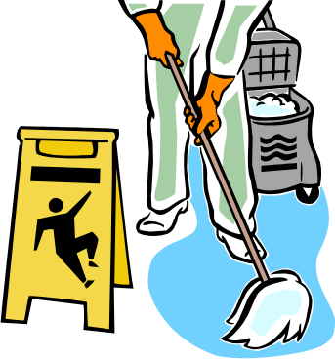
Why do we clean?
Protection of health
Prevention and control of infection
Improvement of living conditions for service users
Improving working conditions for staff
Areas that are physically clean and dry are unlikely to represent a cross infection risk

Slide 4
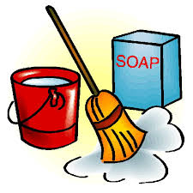
Environmental Cleanliness
People have a right to be cared for in a clean, tidy and safe environment.
Dust – contains dead skin scales
Why is dust harmful
  Microorganisms that live on skin can live in dust for long periods of time
Minimising dust and dirt
  The aim of cleaning is to make the care environment free from dust and dirt.
    Clean surfaces with a damp cloth
    Allow to dry completely
    Use separate cloths for different areas to stop microorganisms being transferred from one area to another

Slide 5
However:
Some situations require cleaning and disinfection to be carried out
  Outbreaks
  Clients who have an alert organism – MRSA,
Disinfection is a process that reduces micro-organisms to a safe level – it is a 2 step process
Surfaces must be cleaned with detergent and then cleaned with the disinfection solution

Slide 6
Disinfection
Disinfectant must be diluted to the correct strength to work correctly
Chlorine based/Hyperchlorite products and should be diluted to 1000 parts per million (PPM)
They can be corrosive so may require rinsing once they have dried on surfaces such as mattresses and commodes etc.
Always ensure that surfaces that are being disinfected are compatible with the product being used.

Slide 7
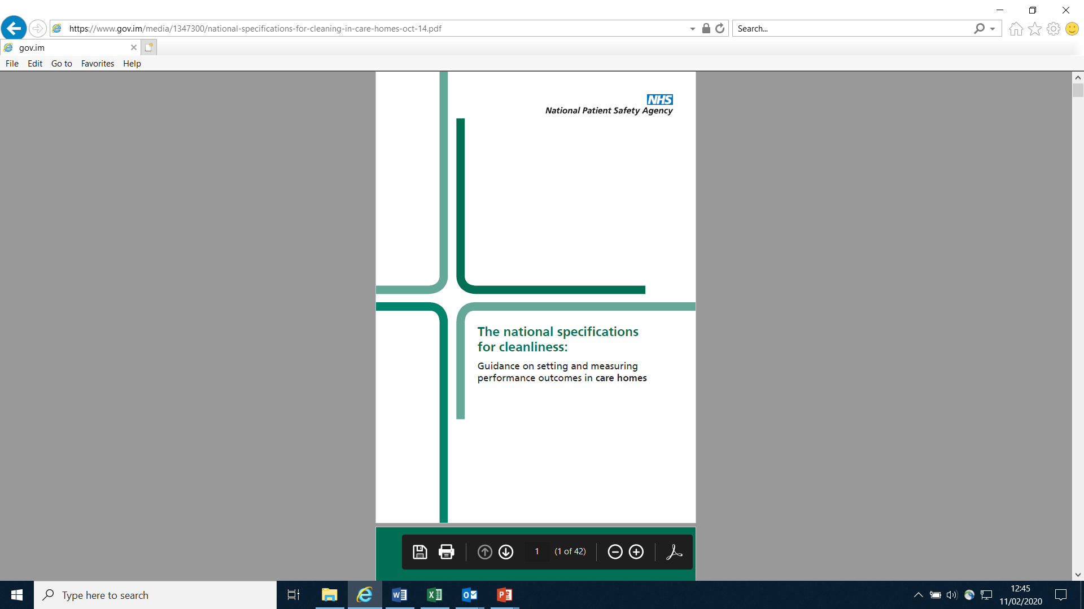
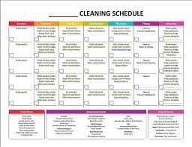
Cleaning Schedules
National specification for cleanliness in in care homes
Each practice should have a cleaning schedule
Cleaning schedule should identify:
  What is cleaned
  How is it cleaned
  When should it be cleaned - frequency
  What cleaning product should be used
  What is the correct cloth/mop/bucket etc. to use.

Slide 8
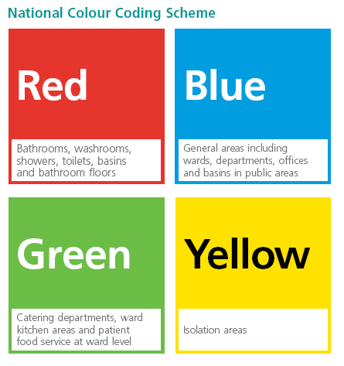
Colour Coding

Slide 9
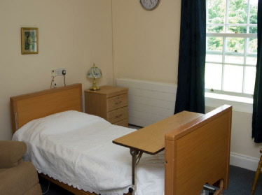
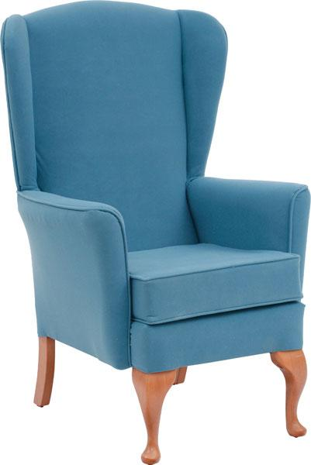
Environment and Cleaning
  Routine cleaning should be carried out daily using detergent
  Don’t forget high surfaces
  Don’t forget behind radiators and cupboards etc.
  Soft furnishings

Slide 10
Education and Training
Cleaning staff should receive IPC training along with their cleaning training
They need to understand the importance of cleaning
All care staff should understand the importance of cleanliness and what items or areas are their responsibility

Slide 11


