Slide 1

Hertfordshire’s Assistive Technology solution
Data Inspired Living
19 March 2025
© Hertfordshire County Council 2025

Slide 2

Background
Hertfordshire County Council has a telecare service that has transitioned from analogue to digital which provides a reactive emergency response
In 2019, the Council outlined its vision to use modern digital technology to transform the way that care services are provided and support Hertfordshire’s residents to live healthy and fulfilling lives
This digital strategy recognised the need to think differently to help address financial challenges in local government
We wanted to identify emerging problems and work preventatively, reducing risk of needing crisis interventions
A dedicated Assistive Technology Team was established to underpin the delivery of the strategy’s ambitions.
In depth research and analysis led us to develop our own solution in Data Inspired Living

Slide 3

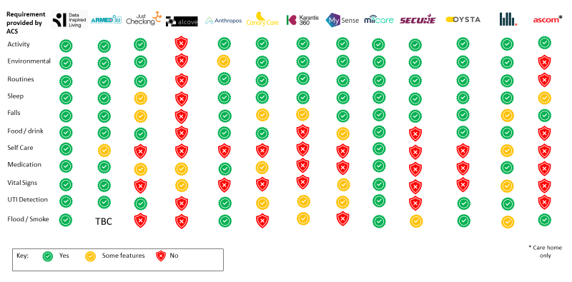

Co-produced and developed in house
Extensive competitor research revealed what we wanted and needed to support our residents was not available
Wanted something unique to Hertfordshire County Council that would support practitioners: a digital tool to improve their practice and crucially support and improve outcomes for residents and support our Connected Lives framework
Shared inputs from practitioners to iterate, build and test the Assistive Technology solution.

Slide 4

Our AT solution
Data Inspired Living is a digital tool for social care practitioners to use as part of care planning for the residents we support and for carers to have an understanding when someone’s normal routine may vary.
It consists of an online dashboard, which provides a view of residents’ routines at home using various small, discreet sensors that are placed around the home that help to build a day-to-day picture of someone’s normal routine.

Slide 5


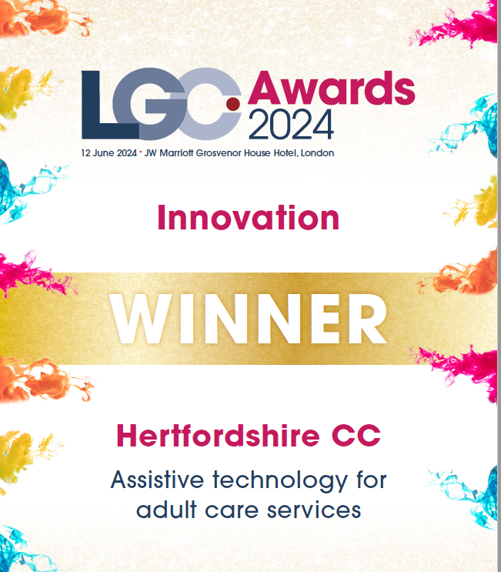
LGC Awards 2024
Shortlisted for LGC Awards in 2 categories - Digital Impact and Innovation
Over 900 entries for 22 categories
Presented DIL to a panel of judges with great feedback
Winner of Innovation Award
The judges were thoroughly impressed with their approach of co-producing technology that is adaptable and scalable, showcasing a true learning culture aimed at continual improvement.
The judges said their dedication, passion, and commitment to innovation serve as an inspiration to us all.

Slide 6
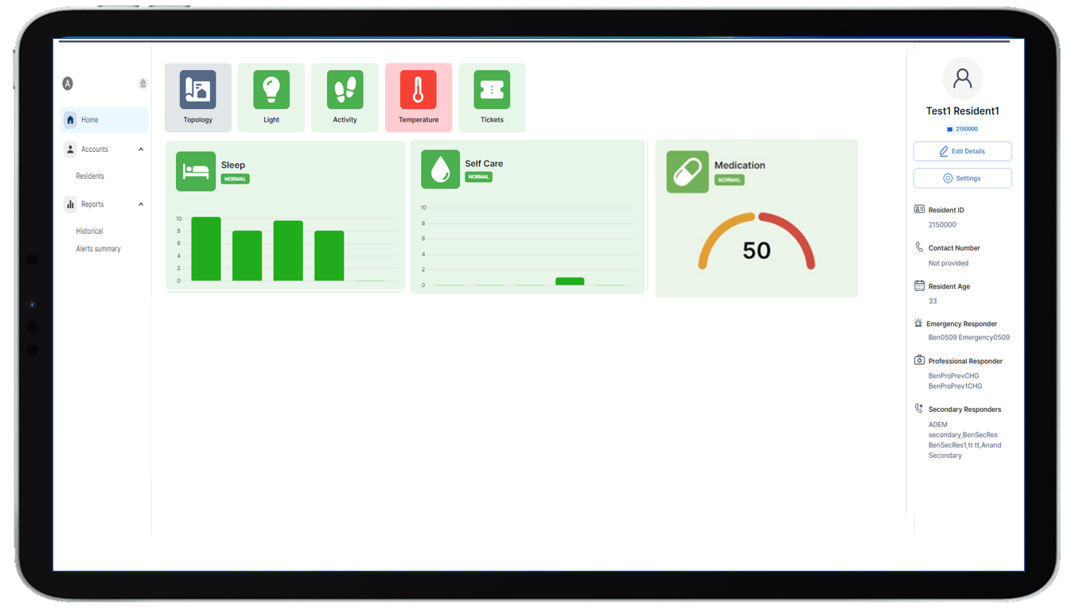
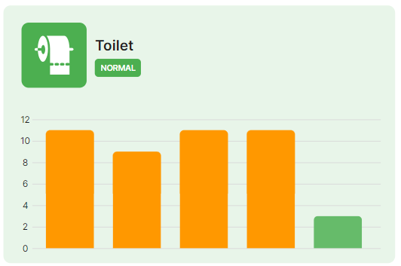
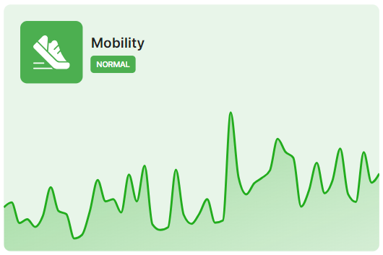
The Dashboard
First of its kind in the UK - “Hertfordshire is leading the way in using artificial intelligence in a societal way and that is the best example of Assistive Technology I have seen so far” Chair, Westminster Briefing on AI, November 2021
The AT professional's dashboard, Data Inspired Living, provides data in real time for sensors installed in a person’s home
It supports us with identifying where there is a change in pattern or behaviour that may signify a change in condition for a person
Preventative alerts are generated to highlight where there is an issue
The AT practitioners manage the HCC in-house preventative service
Data can support care planning, assessments and reviews

Slide 7


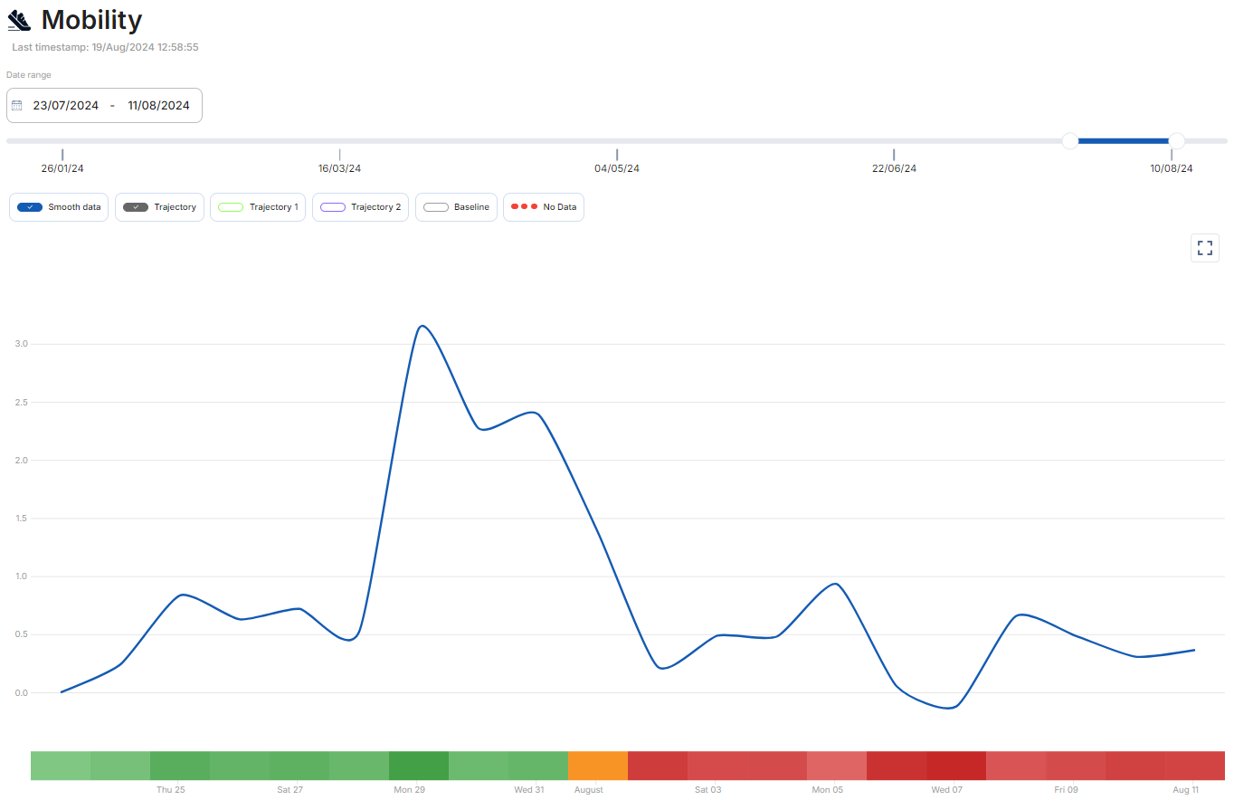
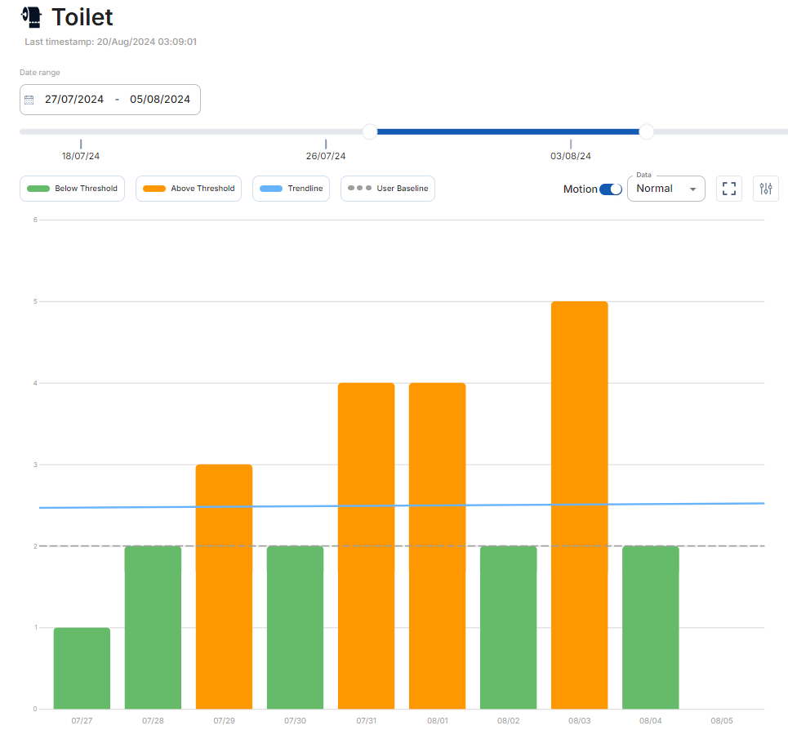

Preventing hospital admission
Jennifer is an 86-year-old lady who lives on her own. She experiences recurrent urinary tract infections (UTI’s) and this has previously resulted in hospital admission. This example shows how a recent UTI was identified.
AT also supports Jennifer by:
Providing reassurance help is on hand when needed
Access to a carer’s dashboard for her sister which also provides reassurance
Identification of changes to routine or pattern and alerts to highlight these
AT can be personalised to the person and relevant sensors installed
Identifying issues has been able to prevent Jennifer experiencing acute symptoms of a UTI and helping prevent further hospital admissions
Alerts were received at the point mobility showed a sharp decline and toilet use increased, indicative of an infection settling. Early contact was made following alerts and family contacted the GP for antibiotics. Jennifer made a quick recovery following this and returned to baseline levels for toilet use and mobility.
Intervention Outcome
Motion sensors in all rooms Resident feels safe and supported
Smart plugs on microwave and kettle No further hospital admissions
Fridge sensor Reassurance for her and her sister
Front and back door sensors Early identification to resolve issues
Toilet flush sensor Automatic alerts generated
Access to the carer’s dashboard Health and wellbeing maintained
© Hertfordshire County Council 2025

Slide 8
Improved outcomes for residents
Residents
Maintaining independence
Remaining at home
Positive impact on health and well being
Working preventatively to support residents and being able to update care providers
Hertfordshire County Council
Cost savings by preventing a move/delay to a residential home
Proportionate packages of care
Support frontline workers in creating time efficiencies
Insights and evidence-based conversations

Slide 9
Creating a cleaner, greener, healthier Hertfordshire

