Slide 1





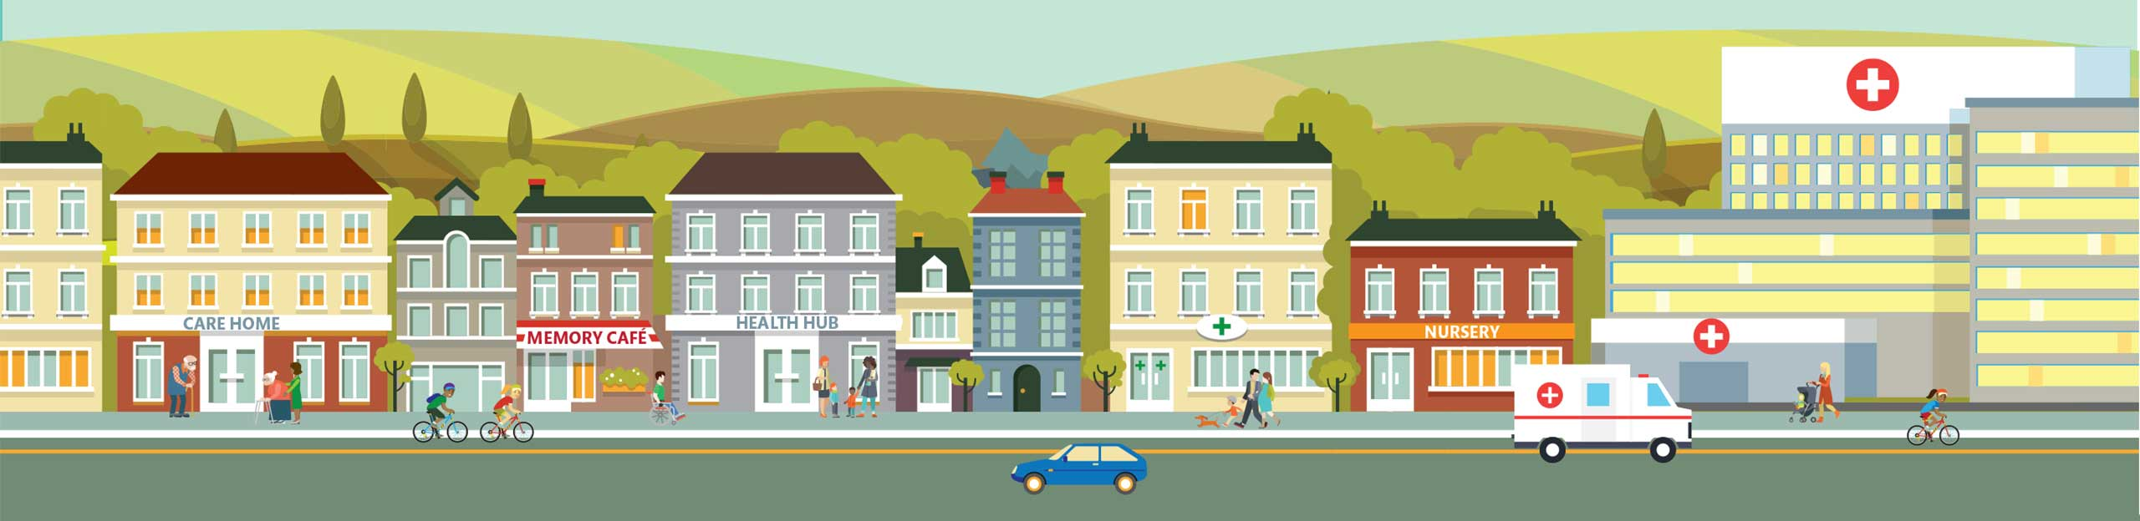
Infection Prevention & Control
Care Providers - 2019/20
NHS E and PHE Programme - Supporting your care homes
Hertfordshire and West Essex
Sustainability and Transformation Partnership

Slide 2

  Contents …
  Chain of infection
  Standard IPC precautions & isolation precautions
  Staff immunisation
  Common infections in the over 65s including Influenza (Flu)
  Recognising signs of deterioration /Sepsis
  Outbreak Recognition and management
  Hydration
  Audits – closing the loop
Notes:
We will be covering the following topics in this pack and encourage you to note down any questions you may have for each section and ask them during the Q&A session.
Mental Health, including the establishment of clear pan London escalation and communication channels and escalation capacity
Acute Medical Model; first wave to commence 01 October 2019

Slide 3
  Purpose of the pack…
Aim:
To provide staff with the information to minimise the risk of transmission of infection to residents/clients/patients, staff and visitors by:
Understanding the impact of Health Care Associated Infections (HCAI)
Refresh knowledge of the chain of infection
Applying best practice in IPC to reduce risk to residents and staff such as immunisations
Increase awareness of common infections in the elderly
Recognise and manage suspected outbreaks, knowing who to report to and obtain support.
We encourage care home teams to use this pack to compliment existing processes and resources; extract information you feel most valuable for your care home.

Slide 4

Importance of Infection prevention
For people living in care homes, infections can be serious, and in some cases, life-threatening. They can also make existing medical conditions worse.
Have you read the NICE ‘quick guide for managers and staff in care homes Helping to prevent infection?
https://www.nice.org.uk/Media/Default/About/NICE-Communities/Social-care/quick-guides/Infection%20prevention.pdf
Notes:
Regular contact with staff, other residents, family and friends and the shared living space all mean infection can easily be passed around. It is therefore vital to take the steps that can help prevent infection occurring.
Having clean hands is the most effective way of preventing infection from spreading. Cleansing your hands is one of the easiest ways to protect yourself and others from illnesses such as food poisoning and flu.
https://www.nice.org.uk/Media/Default/About/NICE-Communities/Social-care/quick-guides/Infection%20prevention.pdf
www.nice.org.uk/cg139 NICE (2012) Prevention and control of Healthcare-associated Infections in Primary and community Care
To continue to be registered with CQC care homes have to demonstrate that they are compliant with the Health & Social Care Act 2008 (Department of Health 2015) Code of practice for the prevention and control of HCAI
a legal requirement to protect patients, workers and others from HCAI
Compliance measured by the Care Quality Commission (CQC)
Compliance measures include application of local policies and best practice programmes, e.g.
5 Moments for Hand Hygiene (World Health Organisation)
NICE guidance
Your residents have the right to expect that those who provide their care meet appropriate standards of hygiene and follow the correct procedures to minimise the risk of transmitting infections

Slide 5

Why infection prevention and control is essential
9% of inpatients affected by an HCAI at any time
  300,000 patients annually (all ages)
Costs around £1 billion
£56 million estimated to be incurred after patients are discharged from hospital.
Results in about 5,000 deaths
  Between 15-30% are preventable
Notes:
Health Care associated infections

Slide 6
Preventing infections
Understanding where the risks are and applying processes to minimise those risks, e.g.
  Recognising that even ’well’ individuals may harbour harmful germs
  Adherence to infection control procedures
  Providing guidance about basic hygiene standards
  Vaccination programmes

Slide 7
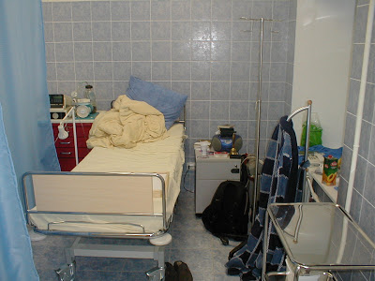

Outcome 8:
People should be cared for in a clean environment and protected from the risk of infection

Slide 8
What can we do to protect ourselves and others?
Apply standard precautions at all times
Ensure vaccinations are up to date and complete
Keep up to date with training and guidance
Reflect on incidents and implement change

Slide 9
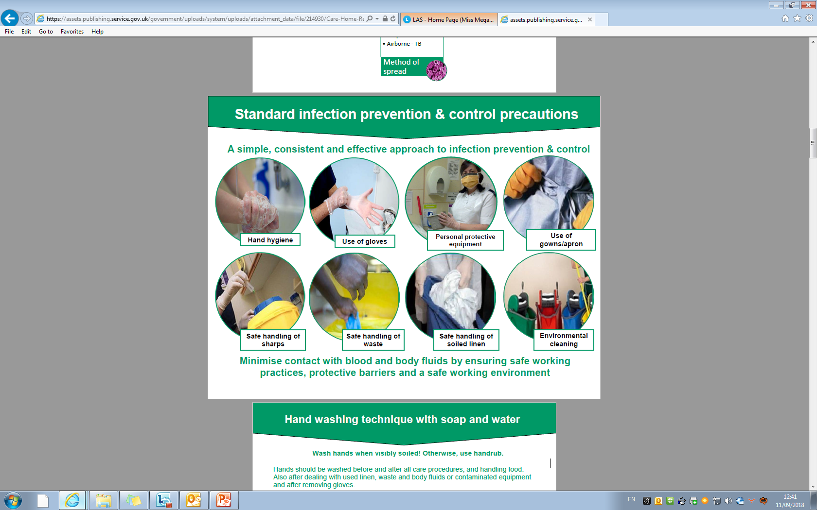
Infection Control measures
Prevention and Control of Infection In Care Homes, Health Protection Agency (2013)

Slide 10
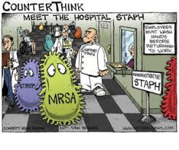
Common infections and outbreaks
Include:
  Urinary tract infection (UTI)
  Chest Infection
  Skin infections/cellulitis
  Gastroenteritis
    Norovirus,
    (sickness and diarrhoea)most common
  Influenza
  Scabies
  Shingles
  MRSA
  Streptococcus A (Scarlet fever)
Notes:
What we do find in care homes are common infections that can cause outbreaks if standard precautions are not adhered to.
UTI a big problem in the community
Gastroenteritis can be caused by bacteria or viruses
Respiratory (influenza)and GI (Norovirus) infections most common

Slide 11
Chain of infection
MRSA
•Clostridium difficile
•Pseudomonas •Norovirus
•Influenza
Organism
Reservoir
Way out of the body
Method of spread
Way into the body
Person at risk
Humans
Animals
Environmental surfaces
Equipment
Food/water
Vulnerable people
Elderly
immunosupressed
Break in skin (wound) cut, needlestick injury
Mucous membranes
(mouth, eyes, nose)
Inhalation
Faeces
Urine
Wound drainage
Blood vomit
Sneeze
Contact –
Hands, Equipment
Droplet - Influenza
Airborne - TB
Notes:
A series of events has to happen to enable germs to cause infections in a person.
We call this the ‘Chain of Infection’.
And if we can break a link at any part of the chain, we can stop infection arising.
THINK about what actions you take to break the chain?
Reservoir:The place where an infectious agent can survive, but may or may not multiply: poorly maintained or poorly cleaned equipment, people even if they are well
the way in which the organism exits the body, Respiratory tract
Mode of spread, unwashed hands
Entry, Respiratory tract, GI, genito urinary,
Person at risk –underlying disease

Slide 12
UTI Quiz
Q1 How much urine should the average adult produce in 24 hours?
A 1.5 Gallons
B 1.5 Pints
C 1.5Litres
Q2 Who is at greater risk of a UTI?
A Men
B Women
C No difference
Notes:
Q2-Urethra shorter
Easier for bacteria that live inside the bowel to get in to the urethra

Slide 13
UTI Quiz cont
Q3 What time of year are UTI’s most common?
A New Year
B Summer
C Spring
Q4 What percentage of residents are prescribed an antibiotic for UTI in a 6/12 period?
A 19%
B 28%
C 43%
Notes:
Q3– Peak of hospital admissions
Q4 depends on care home

Slide 14
UTI diagnosis in the over 65’s References
Care Home “To Dip or Not to Dip” Training Video
https://www.youtube.com/watch?v=rZ5T1Cz7DHQ&feature=youtu.be
PHE UTI Diagnostic Tools
https://www.gov.uk/government/publications/urinary-tract-infection-diagnosis
PHE UTI Leaflet for Older Adults
https://www.rcgp.org.uk/clinical-and-research/resources/toolkits/target-antibiotic-toolkit.aspx (“Leaflets to share with patients”)
Posters
https://www.rcgp.org.uk/clinical-and-research/resources/toolkits/target-antibiotic-toolkit.aspx (“Resources for clinical and waiting areas)
Notes:
Finish at 6.3mins

Slide 15
Antibiotics
Giving an older person antibiotics when they don’t really need them can lead to:
  Side-effects such as rashes & stomach upsets
  C.diff diarrhoea which can be life-threatening
  Antibiotic resistance
    antibiotics won’t work when the person really does need them

Slide 16

Antimicrobial Resistance
Serious global threat
Limited development of new antimicrobial agents
Need to conserve the antimicrobials we have
Need to act now to slow down development of resistance
Notes:
By following IPC principles you can have an impact on the prevention of residents developing an infection and therefore the need for antibiotics reducing the risk of resistance.

Slide 17
Antibiotic Resistance
Antimicrobial resistance is estimated to cause at least 700,000 deaths around the world each year
Predicted to rise to 10 million, alongside a cumulative cost of $100 trillion, by 2050 if no action is taken.
In the western world, UTI is the second most common reason to prescribe antibiotics (Schollun & Walker, 2012).
In 2018, one in three (34%) urine samples analysed in the UK were resistant to trimethoprim antibiotic, compared to 29.1% in 2015.

Slide 18
Chest Infection
Can be viral or bacterial infection.
Usually spread by sneezing and coughing.
Launches droplets into the air which are inhaled by others.
Also spread by poor hand hygiene practices resulting in cross contamination

Slide 19
Who is at risk of developing a chest Infection?
Elderly people
Diabetics
Heart Failure
Asthma/COPD
Compromised immune system
Those with a poor or unsafe swallow

Slide 20
Signs and symptoms of a
Chest Infection
  Persistent cough
  Yellow or green sputum
  Breathlessness - rapid and shallow breathing
  Wheezing
  Increased heart beat/pulse
  Chest pain
  Confused and disorientated
  Reduced mobility
  Fatigue
  Loss of appetite
  Raised temperature

Slide 21
Supporting your resident with a chest infection
Encourage plenty of rest
Encourage plenty of fluids
Treat fever, headaches, aches and pains with paracetamol if tolerated
Raising pillows to assist with breathing/rest
Deep breathing and coughing exercises.
Contact GP for review
Document all care/findings

Slide 22
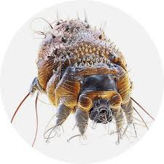
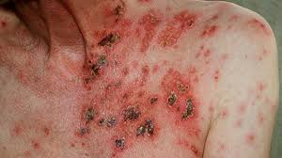
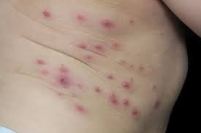
Skin and soft tissue infections
Quite common in elderly people
Causes
  Group A streptococcus (GAS)
  Scabies
  Shingles
Impetigo
Notes:
Group A streptococcus is a bacterium often found in the throat and on the skin. People may carry group A streptococci in the throat or on the skin and have no symptoms of illness.
Most GAS infections are relatively mild illnesses such as "strep throat," or impetigo.

Slide 23
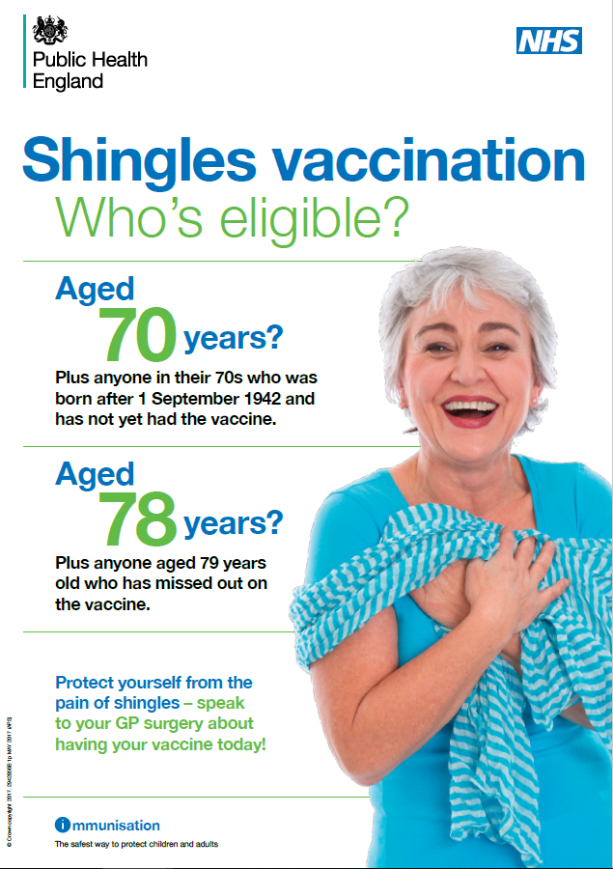
Shingles infection
of a nerve and surrounding skin
caused by the
  herpes varicella-zoster virus, also causes chickenpox.
Following chickenpox infection, virus can lie dormant in the nervous tissue but may reappear as shingles.
It is possible to have shingles more than once.
A shingles vaccination programme
in September 2013.
Notes:
A shingles vaccination programme
in September 2013. This programme
Aims to prevent the complications of Shingles in the
vulnerable ages

Slide 24
Scabies
The female lays two to three eggs a day in burrows in the skin.
After two to four days larvae emerge to mature on the skin surface, and then make new burrows.
They mature, mate, and repeat this cycle that takes 10 to 17 days.
The characteristic rash is not due to the mite itself but to an allergic reaction to the mite, its eggs and faeces.
Spread is normally from person to person via direct skin contact, including sexual contact.
parasitic mite Sarcoptes scabiei variety hominis.
Notes:
They are minute white disc-like arthropods, just too small to be visible to the naked eye. The adult female is around 0.4mm long and 0.3mm wide; males are slightly smaller.
The female lays two to three eggs a day in burrows several millimetres in length in the skin.
After two to four days larvae emerge to mature on the skin surface, and then make new burrows.
They mature, mate, and repeat this cycle that takes 10 to 17 days.
Males die after a short time, but the females live for up to six weeks.
The characteristic rash is not due to the mite itself but to an allergic reaction to the mite, its eggs and faeces.
Spread is normally from person to person via direct skin contact, including sexual contact.

Slide 25
Group A Strep (GAS)
(GAS; Streptococcus pyogenes) is a bacterium which can colonise the throat, skin and anogenital tract.
It causes a diverse range of skin, soft tissue and respiratory tract infections, including:
  tonsillitis
  pharyngitis
  scarlet fever
GAS can occasionally cause infections that are extremely severe.
The organism can be transmitted from patients in the community via unwashed hands and reusable equipment that is not cleaned between patients/residents
Notes:
Group A Streptococcus (GAS; Streptococcus pyogenes) is a bacterium which can colonise the throat, skin and anogenital tract.
It causes a diverse range of skin, soft tissue and respiratory tract infections, including:
tonsillitis
pharyngitis
scarlet fever
impetigo
erysipelas
cellulitis
pneumonia
GAS can occasionally cause infections that are extremely severe. Invasive GAS (iGAS) is an infection where the bacteria is isolated from a normally sterile body site, such as the blood
GAS is spread by close contact between individuals, through:
•respiratory droplets
•direct skin contact
It can also be transmitted environmentally, through:
•contact with contaminated objects, such as towels or bedding
•ingestion of food inoculated by a carrier

Slide 26
Gastroenteritis
Gastroenteritis can be caused by bacteria or viruses
Common organisms
  Clostridioides difficile infection
  Norovirus
  Food borne such as Salmonella, Campylobacter or Shigella

Slide 27

CDI – Risk Factors
commonly affects people who have recently been treated with antibiotics (taking broad spectrum antibiotics that disturb balance of gut flora)
Proton pump inhibitors (e.g. omeprazole)
Compromised immune system
Repeated enemas and gut surgery
Long term hospital stay

Slide 28
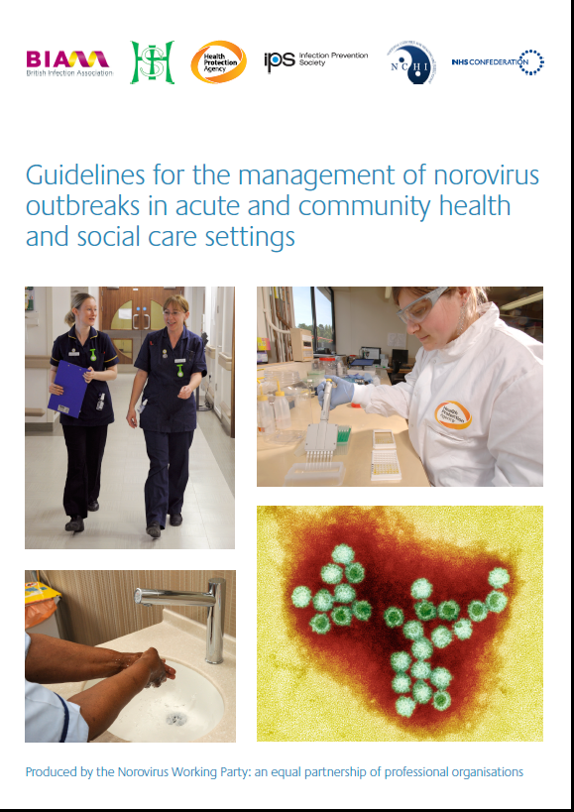
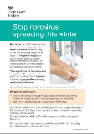
Norovirus
Different strains = 32 sero-types
Illness is generally mild and recovery usually within 2-3 days.
There are usually no long term effects that result from being infected.
Can be carrier - infected but not symptomatic
Primarily person-to-person by faecal-oral route - Aerosols from vomit
Environmental contamination from projectile vomiting
  disinfect area (after cleaning) with 1000ppm of available chlorine
No longer seasonal – can occur any time of year
Treatment:
  None, encourage oral fluids and rest – prevent dehydration
https://www.gov.uk/government/publications/stop-norovirus-spreading-this-winter-leaflet
Notes:
Treatment:
None, encourage oral fluids and rest – prevent dehydration as may lead to preventable admission to acute care and further impact

Slide 29
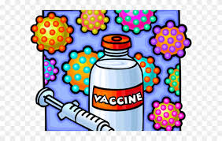
Staff Immunisations
Recommended vaccinations
  Annual Influenza
  Hepatitis B course
  MMR (Measles Mumps and Rubella)
  Varicella (chickenpox)

Slide 30

Influenza
Notes:
There are many sources of bacteria that can cause illness and disease in our lives – mostly outside of the hospital setting. Keeping ourselves fit and healthy will support our own bodies defence against illness.
We don’t live in a sterile world.

Slide 31
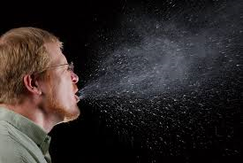

How is influenza spread?
Spreads easily from person to person through breathing, coughing and sneezing.
The virus can also be spread when a person touches influenza droplets and then touches their own mouth or nose before washing their hands.
Notes:
NB: Double click the horn for the sound of a cough then a sneeze. A quick check to see if you are awake!
An infected person can spread the flu virus to others even before feeling sick. An infected adult can spread the virus from about one day before and up to five days after symptoms start. Children can spread the virus for a longer time – up to six days before and 21 days after the symptoms start.
Influenza and other respiratory infections are a major cause of hospitalisation, morbidity and death among the elderly. Underlying chronic health conditions make patients both more susceptible and vulnerable to severe disease1, and hospitalisation rates during outbreaks can be high. Respiratory infections may also spread rapidly in care homes, resulting in high attack rates due to prolonged close contacts between residents, and between patients and their carers2,3.

Slide 32



  What care homes need to do for residents?
        Flu vaccine – to protect against Influenza
        Pneumococcal vaccine – to protect against invasive Pneumococcal disease
        Shingles vaccine – to protect against Shingles (recommended for those aged >70yrs)
Have all your residents been offered their vaccinations this year?
Ensure your care home residents have been offered the following vaccines…
Who will provide the vaccinations for our residents?
Notes:
https://www.nhs.uk/conditions/flu/
https://www.nhs.uk/conditions/vaccinations/pneumococcal-vaccination/
https://www.nhs.uk/conditions/shingles/

Slide 33

  What do our care home staff need to do…
Have you and your staff been vaccinated?
How can staff receive their vaccination?
“If we do one small vaccine, it might make a big difference”
Care Home, Sutton

Slide 34
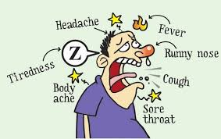
Influenza
Spread primarily by close contact
  Droplet
  Direct contact
  Coughing
Respiratory viruses may remain on surfaces for several hours.
Incubation period: The usual incubation period of influenza is two days (range 1-4).
Period of infectiousness: Starts with the onset of symptoms and lasts for the duration of symptoms.
Notes:
Viral shedding following influenza infection can be prolonged among some elderly persons, particularly among people with chronic long-term medical conditions and individuals on immunosuppressive therapy i.e. chemtherapy. Hence, isolation of patients and infection control precautions in care homes in a confirmed influenza outbreak may need to be applied for a longer period of time than 5 days.

Slide 35
  What do our care home staff need to do…
All health and social care staff can get free flu vaccine under the national flu vaccination scheme.
Includes staff employed by a registered…
Residential care/nursing
Domiciliary care provider
directly involved in the care of vulnerable* patients/clients at increased risk from exposure to Flu (influenza).
*Vulnerable means those patients/clients in a clinical risk group for flu or who are aged 65 years and over.
You just need to take your ID into a pharmacy

Slide 36
True or False?
Influenza is not a serious disease
FALSE
Fact: Influenza is highly contagious and potentially life threatening disease not the same as a cold
You can get the flu from a flu shot.
FALSE
Fact: No vaccine does not contain any live viruses and therefore cannot cause the illness
You can spread the flu before you know you’re sick.
TRUE
Fact: You can pass it to someone before you have symptoms, while you’re sick, and up to a week after you start feeling bad.
Notes:
Mythconceptions
Flu shots are made with dead viruses or pieces (proteins) from the flu virus
You can pass it to someone before you have symptoms, while you’re sick, and up to a week after you start feeling bad.

Slide 37
True or False?
People do not need to get vaccinated if they are healthy
FALSE
Fact: anyone can contract influenza being fit and healthy does not protect you
It is not necessary to get vaccinated every year
FALSE
Fact: the types of influenza viruses change every year, a new vaccine is made every year
Notes:
Mythconceptions
Flu shots are made with dead viruses or pieces (proteins) from the flu virus
You can pass it to someone before you have symptoms, while you’re sick, and up to a week after you start feeling bad.

Slide 38
True or False?
People should get vaccinated against influenza if they are sick
TRUE
Fact: minor illnesses without fever should not prevent vaccination, especially if one of the at risk groups
Influenza vaccine causes serious adverse events
FALSE
Fact: SAE are rare most common being local redness and swelling
Notes:
The flu that’s keeping your partner in bed might not be the same one that made your aunt sick last year. That’s because flu viruses are always changing. They can vary from year to year. They can even change in the middle of a flu season.

Slide 39
True or False?
The flu isn’t serious.
FALSE
Fact - You can get pneumonia or even respiratory failure. The flu is most dangerous for children, people ages 65 and older, and those with other health problems.
You have to be near someone to get the flu
FALSE
Fact- People with the flu can give it to anyone within about 6 feet
Notes:
They can get pneumonia or even respiratory failure. The flu is most dangerous for children, people ages 65 and older, and those with other health problems. About 90% of people who die from the flu are older adults. Flu is the top cause of vaccine-preventable deaths in the United States.
. (Keep that in mind the next time you’re on a bus or a train and someone is coughing and sneezing.) The flu usually spreads when a sick person coughs, sneezes, or talks. Droplets of saliva and mucus can travel to your nose or mouth. You can also get the flu by touching something like a door handle or a phone with the virus on it.

Slide 40
You can catch the flu from going out with wet hair.
FALSE
  Mom wasn’t right about this one. Heading out with wet hair won’t raise your chances of getting the flu. (And neither will going out in the cold without a coat.)The only way you can get it is by being exposed to the virus.

Slide 41
True or False?
Antibiotics help with the flu.
FALSE
Antibiotics are medicines used to treat infections caused by bacteria. Antibiotics don't work against infections caused by viruses, such as colds and flu.
Getting a flu shot late is better than skipping it.
TRUE
It takes about 2 weeks to work, so it’s best to get it before flu season starts. Flu season is usually the worst from December through February, but can last well past that.
Notes:
Get your flu shot as soon as the vaccine is available in the fall. It takes about 2 weeks to work, so it’s best to get it before flu season is in full swing. If you’ve put it off past November, the shot can still help protect you. Flu season is usually the worst from December through February, but it can last well past that
Antibiotics are medications that fight infections caused by bacteria, but the flu is cause by a virus. Taking antibiotics when you have a virus may do more harm than good. Taking antibiotics when they are not needed increases your risk of getting an infection later that may resist antibiotic treatment
They only help with infections caused by bacteria. Antiviral drugs (Tamiflu) (Relenza) can fight the flu virus and make you feel better faster. They work best if you take them within 2 days of getting sick, if you think you have flu symptoms.

Slide 42
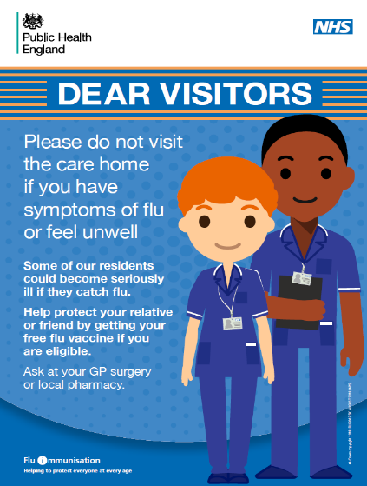
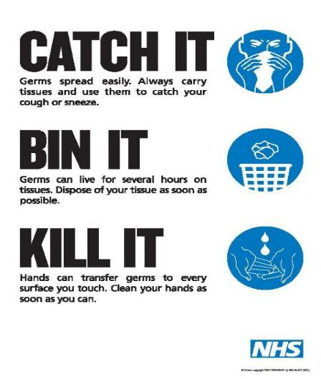
Prevent the infection
https://assets.publishing.service.gov.uk/government/uploads/system/uploads/attachment_data/file/735380/Flu_Poster_for_care-homes_.pdf

Slide 43
Outbreak Recognition & Management
It is important to recognise potential outbreaks promptly
It is vital that care staff implement control measures as soon as possible to prevent further cases.
Staff must be aware of the signs of infection, particularly in the elderly, e.g. fever, diarrhoea or vomiting, unexpected falls and confusion.
Staff must know to report the signs immediately to senior management staff

Slide 44
Why and how outbreaks happen
Care home residents share air, space, food and equipment, so they also share organisms that can easily cause infection outbreaks.
Residents are also more prone and vulnerable to infections, which can lead to death.
Infectious agents can survive in and on people, as well as in the environment
Vulnerable residents have frequent contacts with staff, other residents, visitors and the environment
The immune system of vulnerable residents can be easily overwhelmed
The influenza virus and norovirus (both common causes of outbreaks in care homes) can survive in the environment for one to two days and up to seven days respectively. Staphylococcal bacteria can survive for several months.

Slide 45
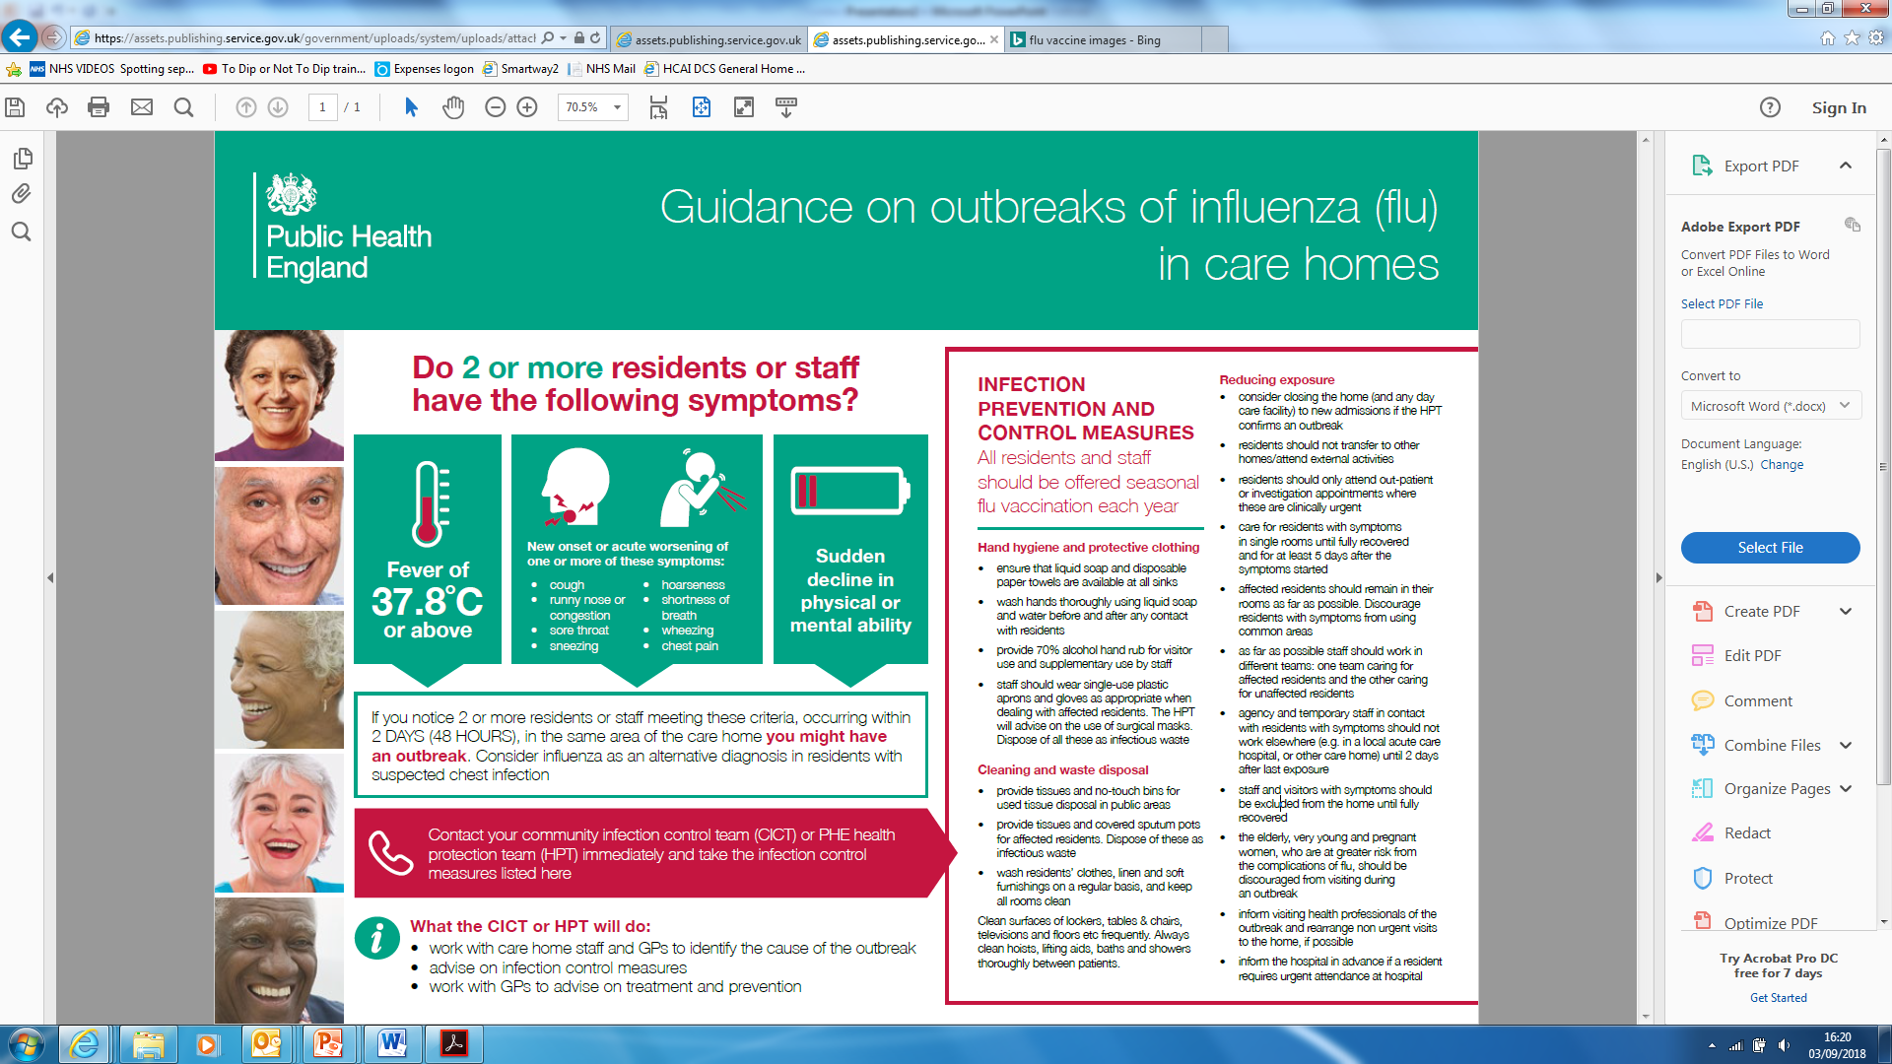
Recognise a potential Flu outbreak early
Wherever possible discuss with GP before calling the HPT

Slide 46
Immediate actions to take if a flu outbreak occurs…
Step 1
If you have residents showing flu-like signs and symptoms contact your resident’s GP during practice hours or NHS 111 *6 (dial 111 and press *6) to seek senior clinical advice and guidance on how to manage the clinical care of all symptomatic residents within the home.
Step 2
Contact your local Health Protection Team once you have spoken to a GP to inform them about the suspected outbreak. Visit the website www.gov.uk for your Local Health Protection team contact details.
Step 3: If urgent clinical support required
If you have contacted your residents GP but your resident is starting to deteriorate before they arrive on-scene, contact NHS 111 *6 (dial 111 and press *6) to speak to a GP or Senior Clinician for further advice.
Notes:
If you have residents showing flu-like signs and symptoms contact your resident’s GP during practice hours or NHS 111 *6 (dial 111 and press *6) to seek senior clinical advice and guidance on how to manage the clinical care of all symptomatic residents within the home.
Contact your local Health Protection Team once you have spoken to a GP to inform them about the suspected outbreak. Visit the website www.gov.uk for your Local Health Protection team contact details.
If you have contacted your residents GP but your resident is starting to deteriorate before they arrive on-scene, contact NHS 111 *6 (dial 111 and press *6) to speak to a GP or Senior Clinician for further advice.

Slide 47
Sepsis
Dangerous because:
  Speed of infection
  Not recognised early enough
life-threatening condition a rare but serious complication of an infection
can be triggered by minor infections such as urinary tract infections, cystitis, appendicitis, cellulitis, as well as meningitis and pneumonia etc..
Notes:
UK Sepsis Trust Video: https://youtu.be/poN0uBBJemM

Slide 48
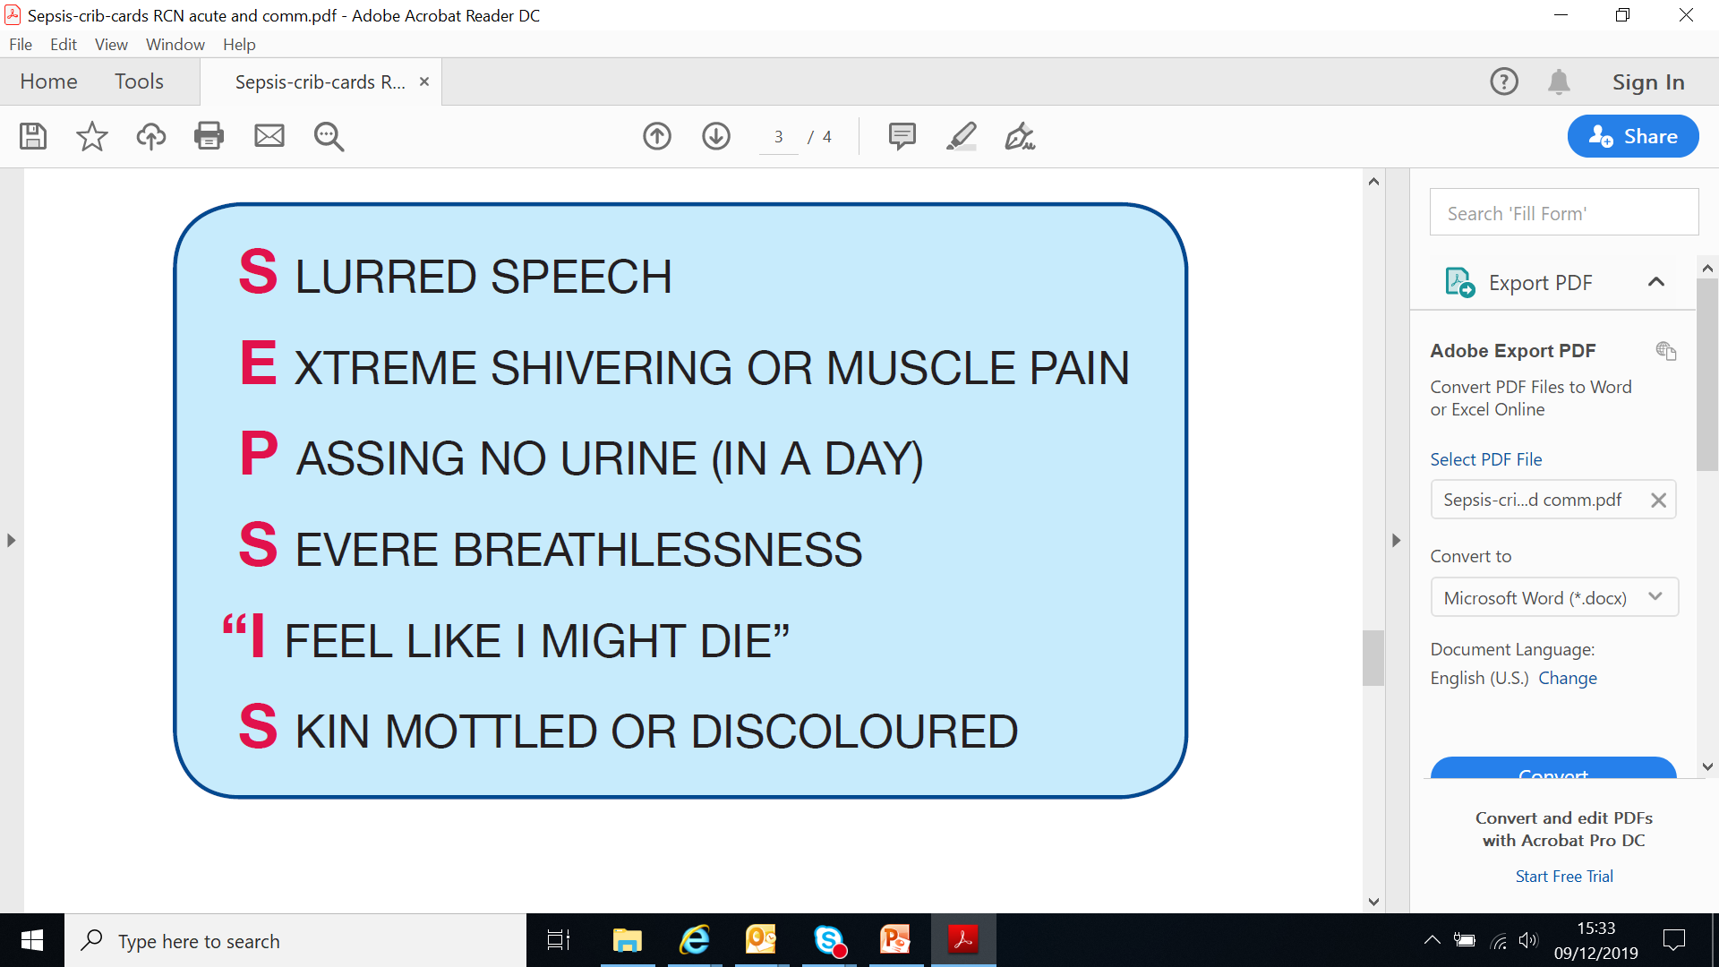
Think Sepsis
Notes:
Sepsis is a life-threatening condition that arises when the body’s response to an infection causes damage to its own tissues and organs.
Sepsis can lead to shock, multiple organ failure and death especially if not recognised early and treated promptly.
These questions will help with assessment for sepsis in the community setting.
Question 1
Does the patient look sick or are they complaining of any of the following symptoms ? See slide
Question 2
If the answer to question 1 is yes, is there a history or signs of an infection?
If the patient has any symptoms from question 1 and has signs of an infection, this may indicate sepsis.
What to do
• Escalate to the most senior health care professional immediately (GP or medical team – consider A&E if the
patient appears severely unwell) - prompt recognition and initiation of treatment for all patients suspected of
having sepsis are vital within the hour.
Depending on the care setting and your skill level, the following may also be undertaken:
• record observations every 30 minutes to include an Early Warning Score and escalate deterioration to a senior
health care professional immediately
• screening – consider microbiological samples if infection present (urine, sputum, blood, wound)
• administer prescribed IV antibiotics within one hour of decision to treat for sepsis.

Slide 49
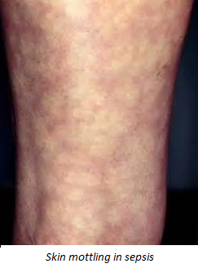
Symptoms of sepsis
Early symptoms may include:
high temperature (fever) or low body temperature
chills and shivering
a fast heartbeat
fast breathing
Later symptoms may include:
feeling dizzy or faint
a change in mental state – such as confusion or disorientation
diarrhoea
nausea and vomiting
slurred speech
severe muscle pain
severe breathlessness
less urine production than normal
cold, clammy and pale or mottled skin
loss of consciousness
Some patients describe a feeling of “impending doom”

Slide 50
The following groups are at a higher risk
very young (under 1 year)
over 75 years or very frail
impaired immune systems including:
  chemotherapy
  who have impaired immune function (e.g., diabetes)
  who have had a splenectomy (or people with sickle cell disease)
  taking long-term steroids
  taking immunosuppressant drugs to treat disorders such as rheumatoid arthritis
who have had surgery, in the past 6 weeks
with any breach of skin integrity (for example, cuts, burns, blisters or skin infections)
who misuse drugs intravenously
with indwelling lines or catheters.

Slide 51
A Patient’s Story
Mandy’s story (UK Sepsis Trust) https://player.vimeo.com/video/165428183?autoplay=1
“One Moment” ENHT Video https://youtu.be/dX7YjKqMv-U
Anna’s story (UK Sepsis Trust) https://player.vimeo.com/video/173604520?autoplay=1

Slide 52
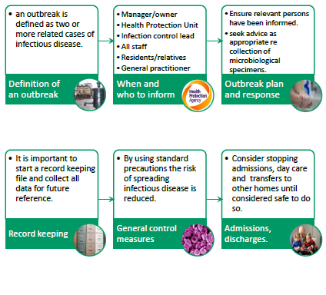

Outbreaks

Slide 53
Outbreak management general principles
Aim to prevent spread
Collect specimens/ record
Inform others
Provide advice
Observe and review
Isolate/exclude/restrict/close

Slide 54
Outbreak Recognition & Management
Important to recognise potential outbreaks promptly
Vital that staff implement control measures as soon as possible to prevent further cases.
Staff must be aware of the signs of infection,
  e.g. fever, diarrhoea or vomiting, unexpected falls and confusion.
Staff must know to report these signs immediately

Slide 55
Timely reporting and keeping a list of who is affected
Isolation of residents with symptoms
Closing units/homes to admissions and transfers
Restricting visitors
Obtaining samples to identify what is causing the outbreak
Exclusion of staff with symptoms
Hand hygiene
PPE-increase
Environmental /equipment cleaning and disinfection
Clear communication
Allocate staff to care for affected residents
Key Control measures during outbreaks
Notes:
HPT will advise whether the home can accept residents being admitted (or transferred back) from hospital during an outbreak
Reduce the amount of socialising in the care home during the outbreak

Slide 56
Continued..
The HPT will recommend closure of the care home to new admissions
Ensure appropriate signage, and advising staff regarding hand hygiene and protective clothing
Residents should not transfer to other homes/day centres or attend external activities
Use disinfectants as part of routine cleaning until outbreak is over
Increase frequency of cleaning
  (door handles, light switches, toilet flushes)
Notes:
Health protection Tean
Ensure appropriate signage is at the entrances warning visitors of the infectio

Slide 57
Outbreak management
Check all staff are applying infection control precautions
If D&V outbreak remove alcohol gel and encourage washing hands with soap and water
Ensure affected residents are well cared for
Notes:
As organisms that cause outbreaks can survive in the care home environment from a few days to several months, it is imperative that all items residents touch are handled carefully, decontaminated effectively or discarded safely. There should be clear guidance as to how to do this

Slide 58
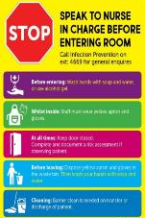
Challenge of Isolation
Single room with ensuite/own commode
Aim of isolation
  Prevent onward transmission by breaking chain of infection
Challenges
  Physical and psychological support
Correct actions when isolating
  Do not leave the isolation room with dirty gloves and apron on
  Remove PPE in room and wash hands prior to leaving
Clear communication
  With resident and family
  Domestic staff (do not share confidential information)

Slide 59
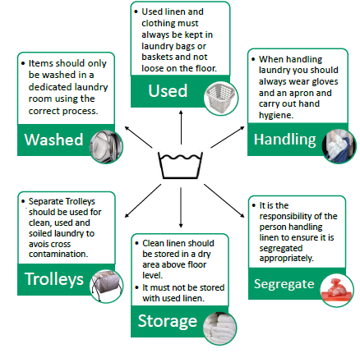
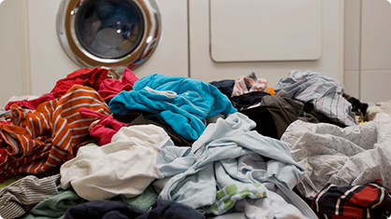
Linen and Laundry
The provision of clean linen is a fundamental requirement

Slide 60
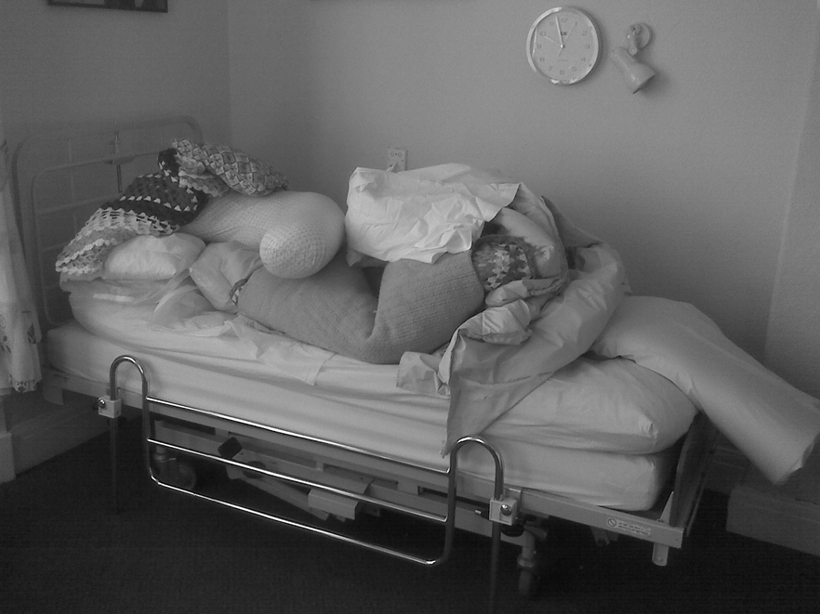
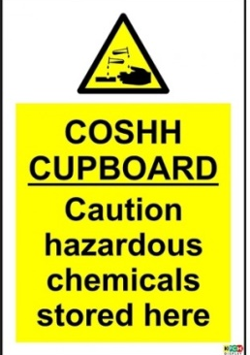
Environmental/Equipment Cleaning
Ensure cleaning products are available, staff have training and stored inline with COSHH
(Control of Substances Hazardous to Health Regulations).
Equipment on loan from HES needs to be returned if no longer required to be decontaminated.
Notes:
Key Messages (http://www.hse.gov.uk/coshh/industry/cleaning.htm CHECKLIST available)
Having your hands wet for a long time or having them frequently wet during the day can irritate your skin leading to dermatitis.
Some ingredients in cleaning products can cause skin allergies and asthma.
Some cleaning products are corrosive and can cause skin burns and eye damage
Prevention
Use good work techniques that avoid or minimise contact with harmful substances and minimise leaks and spills.
Store cleaning products safely.
For some tasks, you may also need to provide personal protective equipment like protective gloves, aprons and eye protection.
Practice good hand care – remove contamination promptly, wash hands properly, dry thoroughly and use skin creams regularly.
Keep the workplace well ventilated.

Slide 61
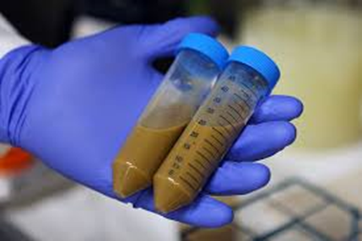
Management and storage of specimens
Specimens need to be clearly labelled
All specimens placed in the plastic pouch attached to the request form and the integral sealing strip properly closed
Specimens should only be taken when there are clinical signs of infection and /or when requested to do so by the Health Protection Unit
Ideally should be transported to the lab on day taken
If it is appropriate to store the sample NEVER store in fridge with medication/food or vaccines
Notes:
Specimens need to be clearly labelled
correct patient details including NHS no.
otherwise you run the risk of rejection by the lab
All specimen primary containers must be placed in the plastic pouch attached to the request form and the integral sealing strip properly closed to contain any spillage and prevent contamination.
Specimens should only be taken when there are clinical signs of infection and /or when requested to do so by the Health Protection Unit
Ideally most samples should be transported to the lab on day taken
If it is appropriate to store the sample NEVER store in fridge with medication/food or vaccines

Slide 62


Hydration
Care home residents are 5 times more likely to be admitted to hospital dehydrated
Are you aware of your residents nutrition and hydration needs?
All residents should have ongoing assessments of their nutrition and hydration needs.
Assessments should also include allergies, likes and dislikes and any support the individual needs to eat and drink.
Be aware not only of each resident’s care needs, but also of their likes and dislikes food-wise
Be on the look out for any changes in your residents nutritional status (e.g. weight, skin, hair etc.).
Improved recognition and early treatment of dehydration will reduce the number of residents being admitted to hospital.

Slide 63


Prevention is better than cure!
Prevent dehydration = prevent UTIs
Why?
Effects?
Forget to drink
Puts strain on kidneys
Bacteria not flushed out of bladder regularly
Sense of thirst lessens with age
Causes constipation
Warm environment
Makes it harder for body to fight infection
Longer periods sitting down
Continence problems
Increase risk of UTI

Slide 64
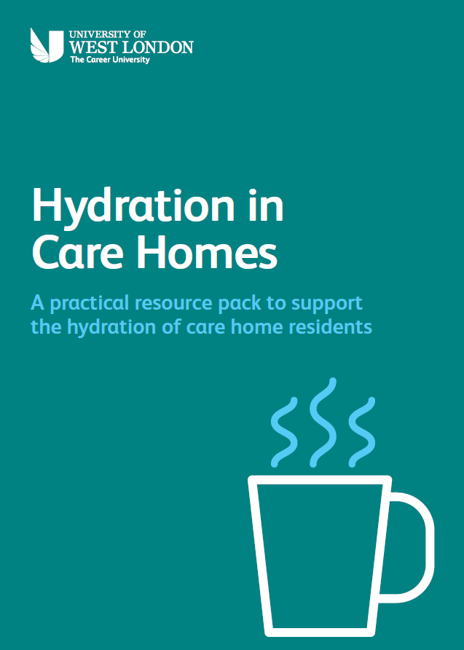
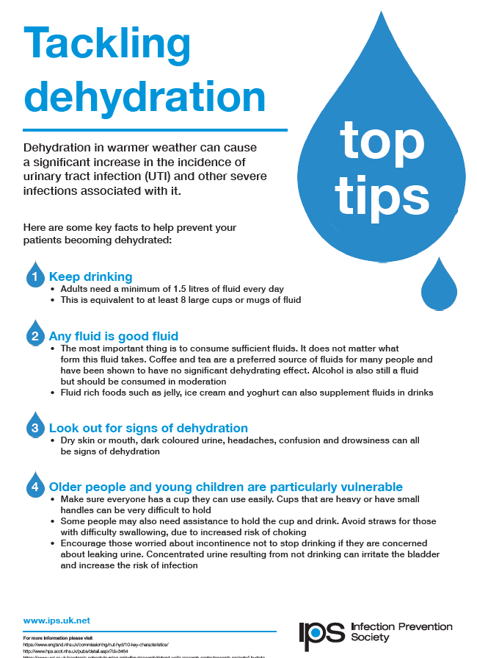
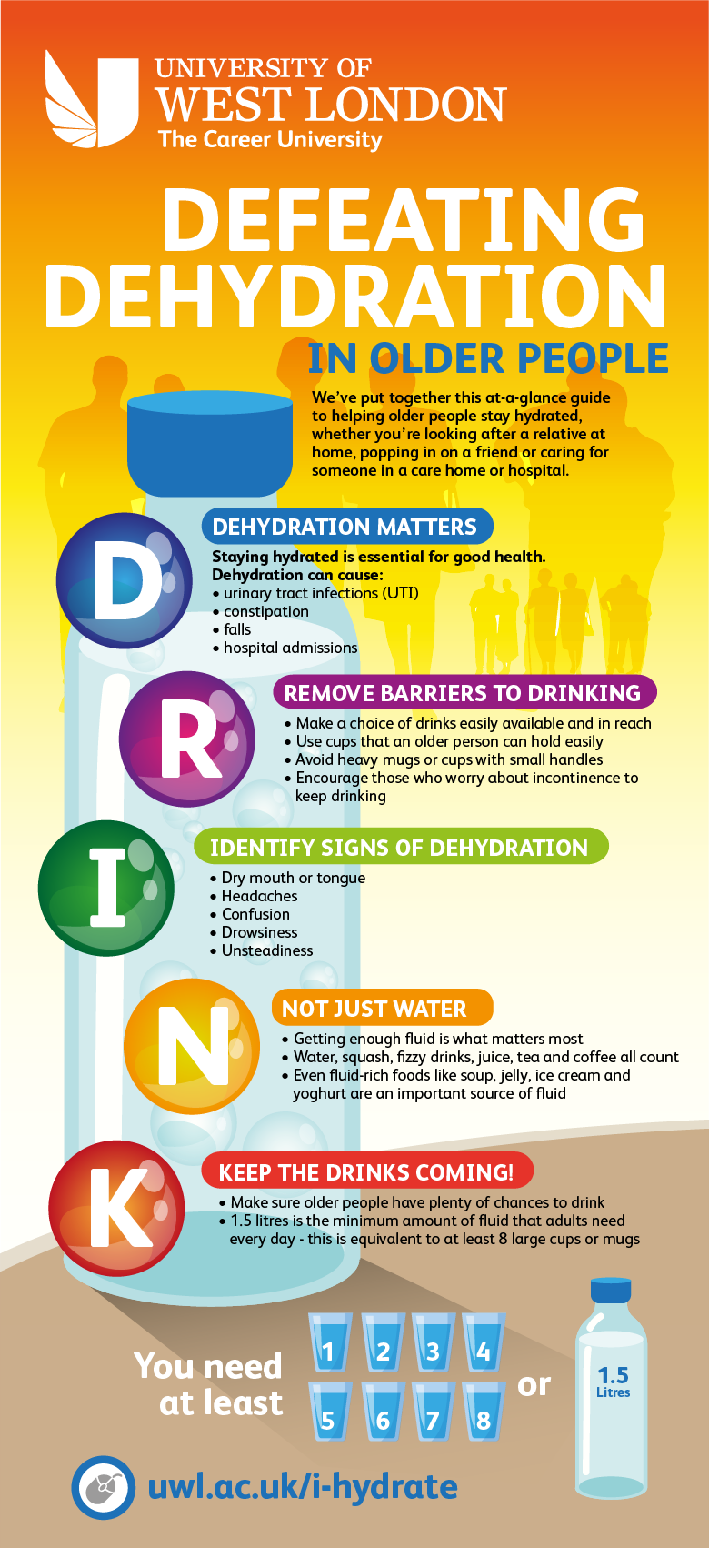
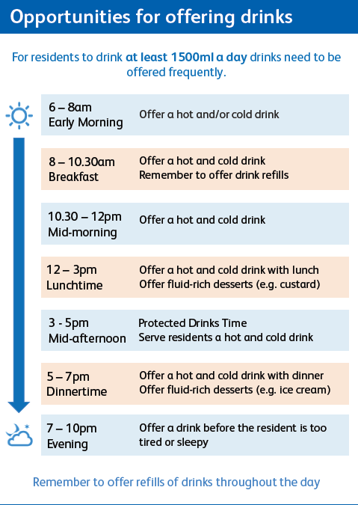
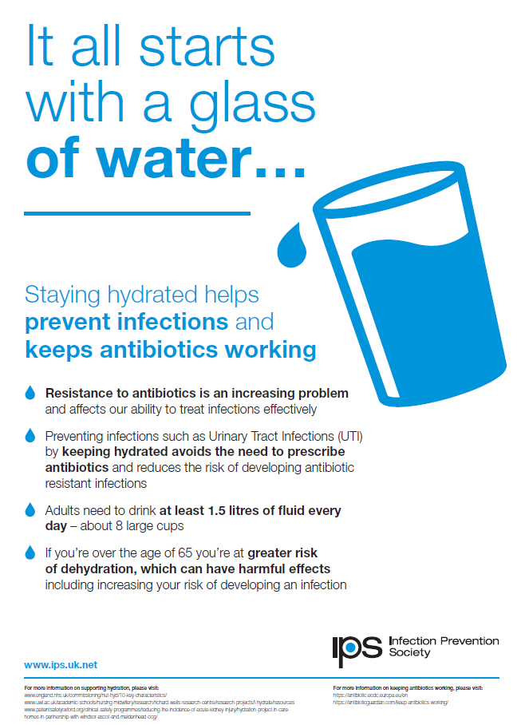
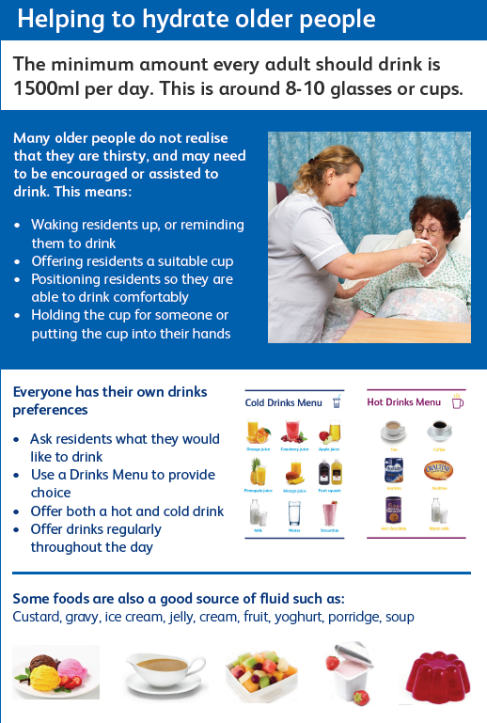
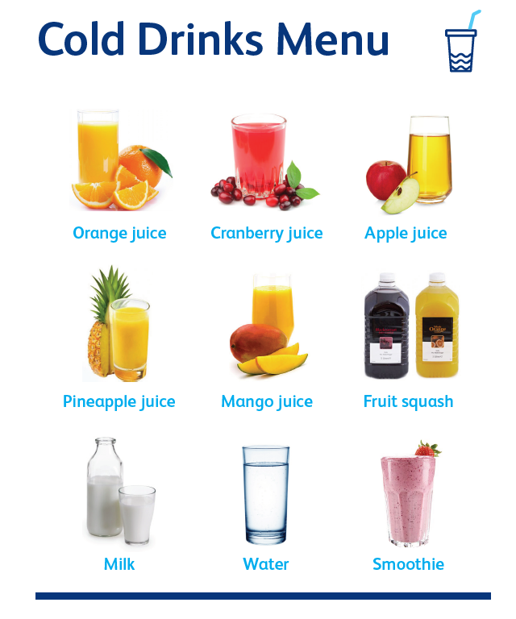
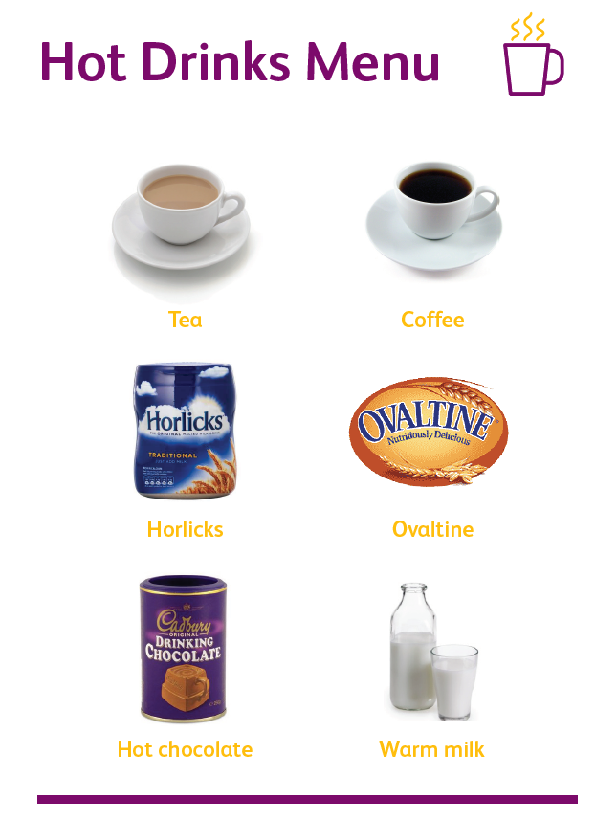
Notes:
Ways to improve hydration in the elderly
Work together on a local project with the aim to improve the hydration of your residents
Here are some ideas to help you

Slide 65

Hand Hygiene
Karen Green

Slide 66
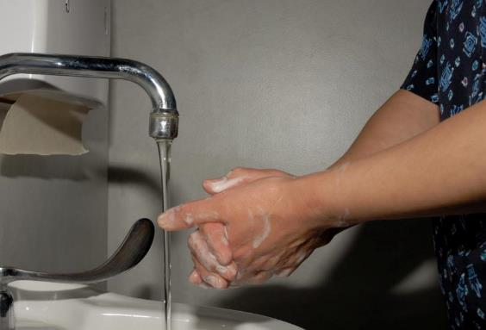
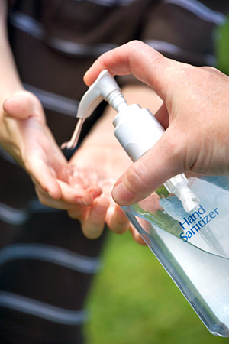
The single most effective way to reduce spread is ...
Notes:
Simple actions prevent the spread of infection - Hand Hygiene remains the single most effective….
Back to the basics - Hand Hygiene – these days it is not just about hand washing – ABHR/G very effective kill rate of bugs.
There is no maximum number of times that ABHR can be used before hands need to be washed with soap and water.

Slide 67
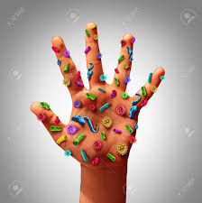
Hand Hygiene
Liquid Soap, Hand Gel and Moisturiser
Hand Gel
Quick and easy to use, except….
  when there is evidence of diarrhoea/ vomiting or diarrhoeal infection;
  when hands are visibly soiled
  When there is direct hand contact with body fluids

Slide 68
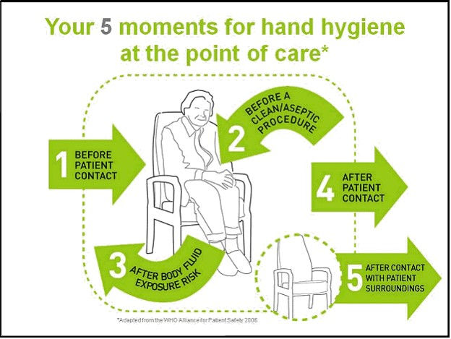
What are the 5 moments of hand hygiene?
Notes:
5 moments don’t change whatever circumstances in this poster WHO used term patient

Slide 69
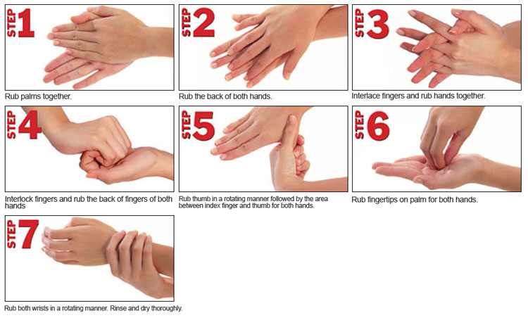
How it’s done

Slide 70
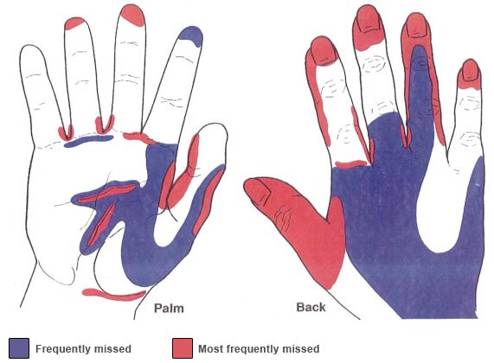
Areas missed!
Notes:
Often people miss areas on there hands.

Slide 71
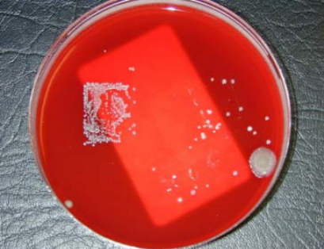
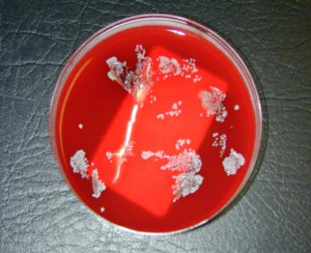
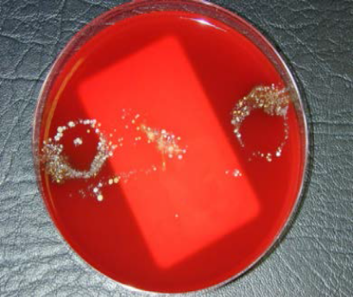
Bare Below the Elbow
Bacterial growth under a watch
Bacterial growth under false nails
Bacterial growth from rings

Slide 72

Jewellery
Total bacteria counts higher when rings are worn
Avoid rings with ridges / stones
Rings interfere with handwashing
Difficulty donning gloves
Gloves may tear
Nails harbour largest number of micro-organisms – keep them short
Artificial nails may increase microbial load and discourage vigorous hand-washing
Notes:
Mention, when not getting rid f micro-organisms from hands you are taking them home with you.

Slide 73
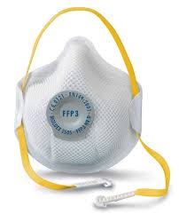
Personal Protective Equipment (PPE)
Includes:
Gloves
Aprons
Eye Protection
Masks and FFP3 (Filtering Face Piece)

Slide 74
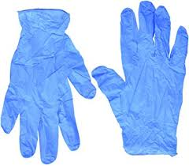
Use of Gloves
Increase in use over recent years
Gloves are not a substitute for handwashing
Hand contamination is possible during glove removal
Hand washing after glove removal is essential and also before sterile glove use
Hypersensitivity to latex is increasing and powder-free gloves should always be used
Gloves must be changed:
  between clean and dirty tasks
  between patients
Notes:
Shouldn’t put a pair of gloves on and then be answering phone with them on etc

Slide 75
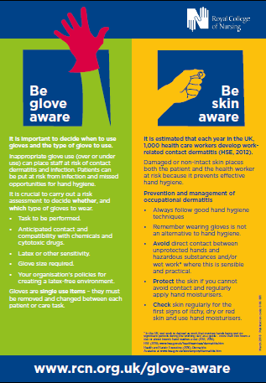
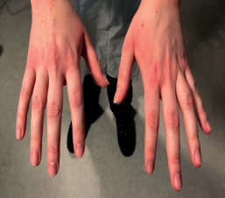
Be Glove Aware ! (RCN campaign)
Approximately one in five nurses/carers develop hand dermatitis –may require staff to be moved out of clinical areas due to the risk of infection from damaged skin.
Hand dermatitis can be caused by frequent exposure to water, cleaning agents and inappropriate glove use.

Slide 76
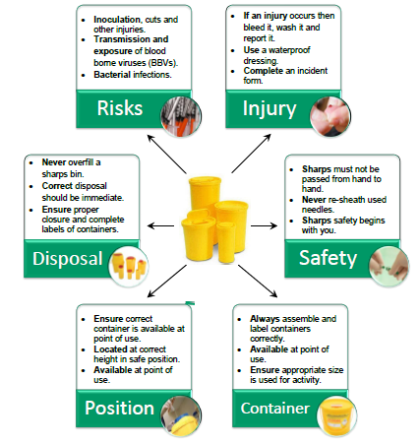
Safe handling and disposal of sharps
Notes:
Use temporary closure in between use & ensure that lid is on correctly - ‘click’ ‘click’ ‘click’

Slide 77
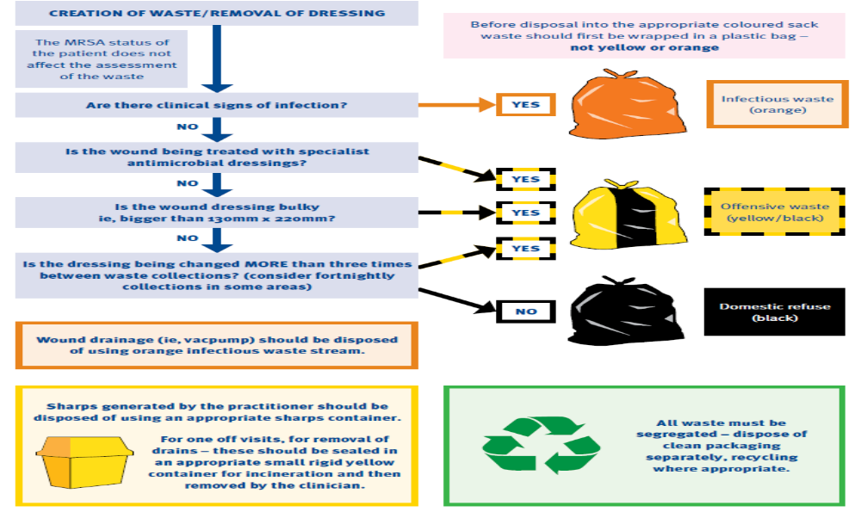
Safe handling of Waste
Notes:
There should be local policies guiding staff on the appropriate segregation of waste in social care

Slide 78
E Coli Blood Stream infections
Urinary tract infections are the most common cause of E. coli blood stream infections and
  lead to the highest number of deaths
Approximately three-quarters of E. coli BSIs occur before people are admitted to hospital.
There is a strong Government focus on reducing preventable E. coli bacteraemia.

Slide 80
Audits – Closing the loop
Important process for ensuring that correct processes are in place and that staff are following the correct procedures.
Also have evidence for CQC registration and your own assurance that the risk is reduced
Supports learning in practice and demonstrating that change has happened
The Infection Prevention Society (IPS) provides audit tools described as quality improvement tools in a specific tool for care homes.
  www.ips.uk.net.
http://www.ips.uk.net/professional-practice/quality-improvement-tools/quality-improvement-tools/

Slide 81
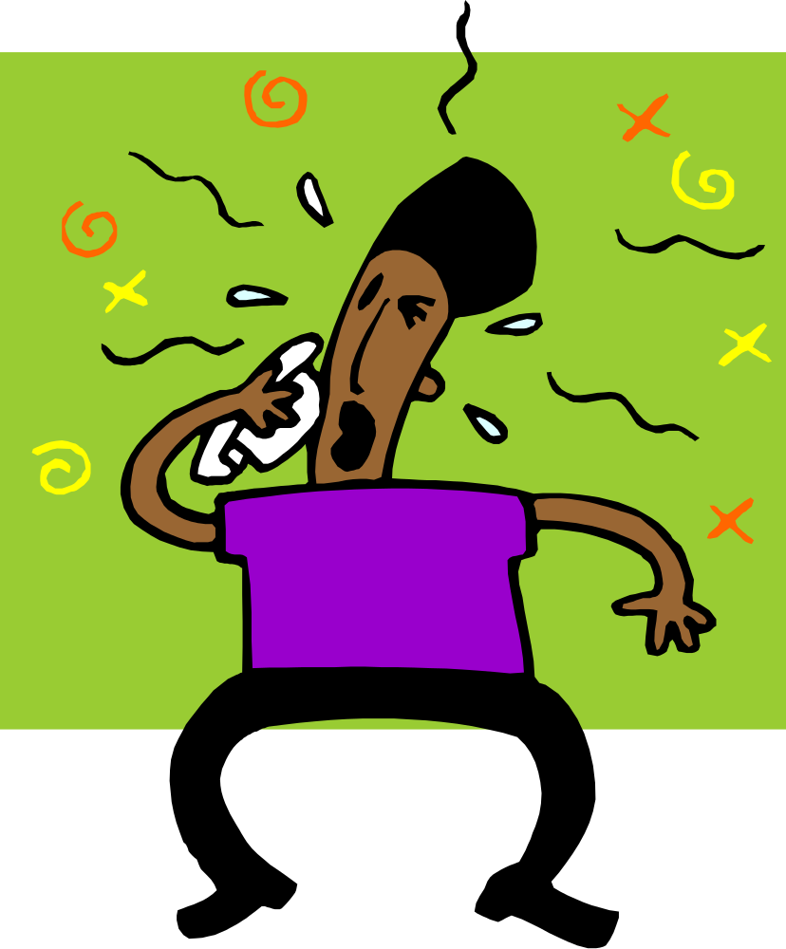
Cough & Sneeze Etiquette
Covering mouth and nose when sneezing or coughing
Use tissues, use once and dispose into a rubbish bin
Perform hand hygiene

Slide 82
Take home messages
Everyone has a responsibility for infection prevention and control
Ensure that you are familiar with the principles of standard IPC to protect yourself, residents and visitors
By following IPC you will reduce the risk of infections and unnecessary use of antimicrobials.
This will reduce the risk of resistance developing
When performed correctly hand hygiene results in a reduction of microorganisms on hands
Effective hand hygiene is the single most important strategy in preventing HCIA
Notes:
Infection prevention and control

Slide 83


